Slide 1

a glance at reinforcement learning
Adam Green adgefficiency.com
adam.green@adgefficiency.com

Slide 2
Course notes
https://github.com/ADGEfficiency/DSR_RL

Slide 3
Agenda
Today
one background & terminology
two introduction to reinforcement learning
three value functions
DQN practical
Tomorrow
four policy gradients
five AlphaGo
six practical concerns
seven beyond the expectation, auxiliary loss functions, inverse RL

Slide 4


B.Eng. – Chemical Engineering
MSc - Advanced Process Design for Energy
education
energy engineer
2011 - 2016
energy data scientist
2017 - present

Slide 5
Today
Learning
Getting excited about reinforcement learning
Seeing state of the art concepts are not too far out of each
Knowing where to look next
These notes are designed as a future reference
First time doing this as a 2 day course – we can take it slow -> ask questions!

Slide 6
Today
Quizzes
answers are on the next slide
if no one knows the answer – read ahead (but still answer!)
Practical
I’ve built an agent based on DQN using TensorFlow
as a group we will run experiments with it
+ some general Python & TensorFlow stuff
Also happy to chat through project ideas

Slide 7
one
nomenclature & definitions
background & terminology

Slide 8
Where to start
Sutton & Barto – Reinforcement Learning: An Introduction
the bible of reinforcement learning
2nd edition in progress
RL Course by David Silver
10 lecture series by lead DeepMind programmer
Li (2017) Deep Reinforcement Learning: An Overview
These are all in the course repo https://github.com/ADGEfficiency/DSR_RL

Slide 9
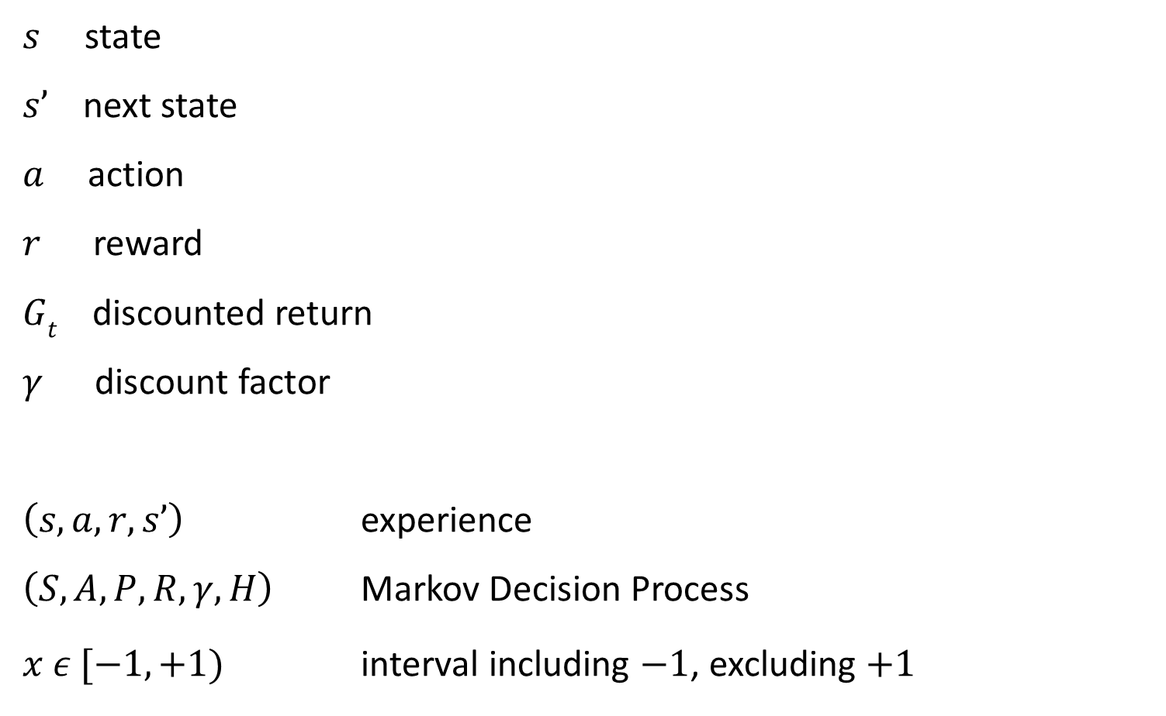
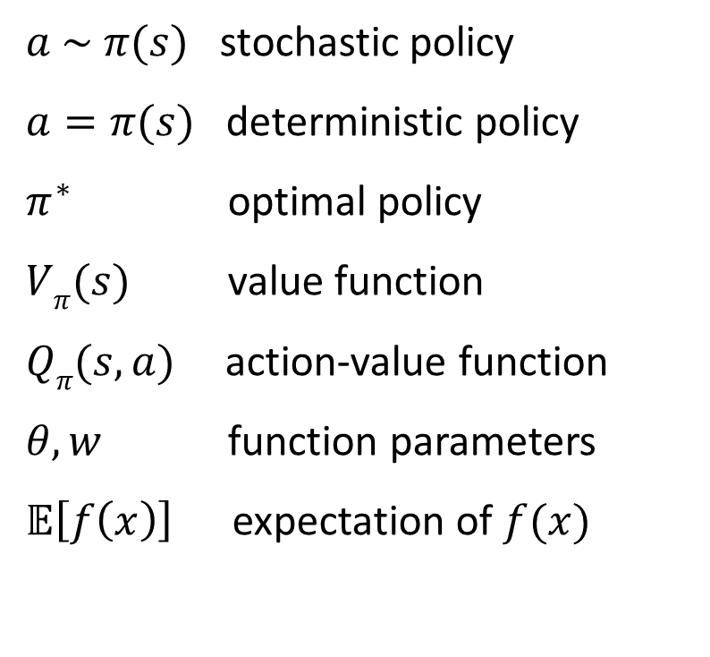
Nomenclature
$s$ state
$s’$next state
$a$ action
$r$ reward
$Gt$ discounted return
$γ$ discount factor
$\left(s, a, r, s’\right)$ experience
$\left(S, A, P, R, γ, H\right)$ Markov Decision Process
$x ε [−1,+1)$ interval including $−1$, excluding $+1$
$a \sim π(s)$ stochastic policy
$a=π(s)$ deterministic policy
$π^{∗}$ optimal policy
$Vπ(s)$ value function
$Qπ(s, a)$action-value function
$θ, w$ function parameters
$𝔼\left[f\left(x\right)\right]$expectation of $f(x)$

Slide 10
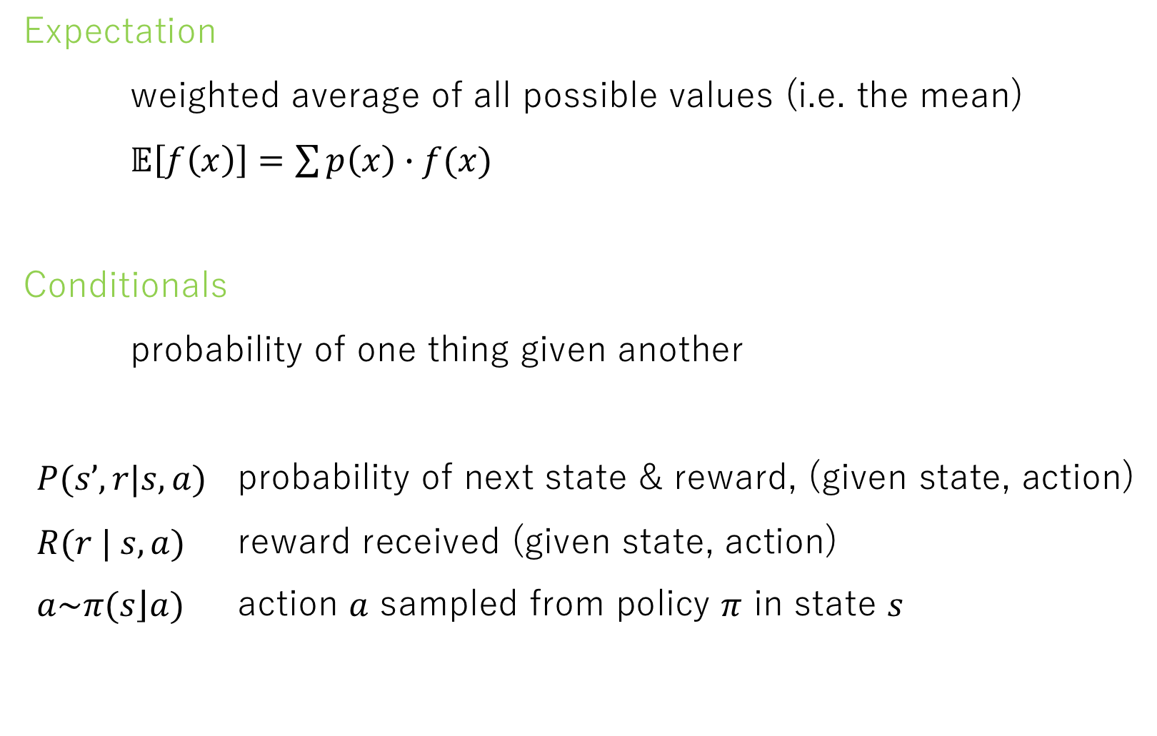
Definitions
Expectation
weighted average of all possible values (i.e. the mean)
$𝔼\left[f\left(x\right)\right]=\sum{p\left(x\right)∙f(x)}$
Conditionals
probability of one thing given another
$P(s’, r|s,a)$ probability of next state & reward, (given state, action)
$R(r | s, a)$ reward received (given state, action)
$a\sim π(\left.s\right\rfloor a)$ action $a$ sampled from policy $π$ in state $s$

Slide 11
Variance & bias in supervised learning
Model generalization error = bias + variance + noise
Variance
error from sensitivity to noise in data set
model sees patterns that aren’t there -> overfitting
Bias
error from assumptions in the learning algorithm
model can miss relevant patterns -> underfitting

Slide 12
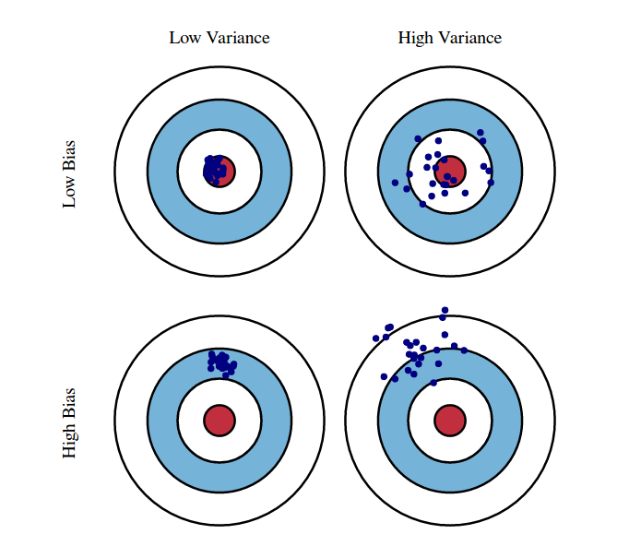
Variance & bias in reinforcement learning
Variance
deviation from expected value
how consistent is my model / sampling
can often be dealt with by sampling more
sample inefficient
Bias
expected deviation vs true value
how close to the truth is my model
approximations or bootstrapping tend to introduce bias
biased away from an optimal agent / policy

Slide 13
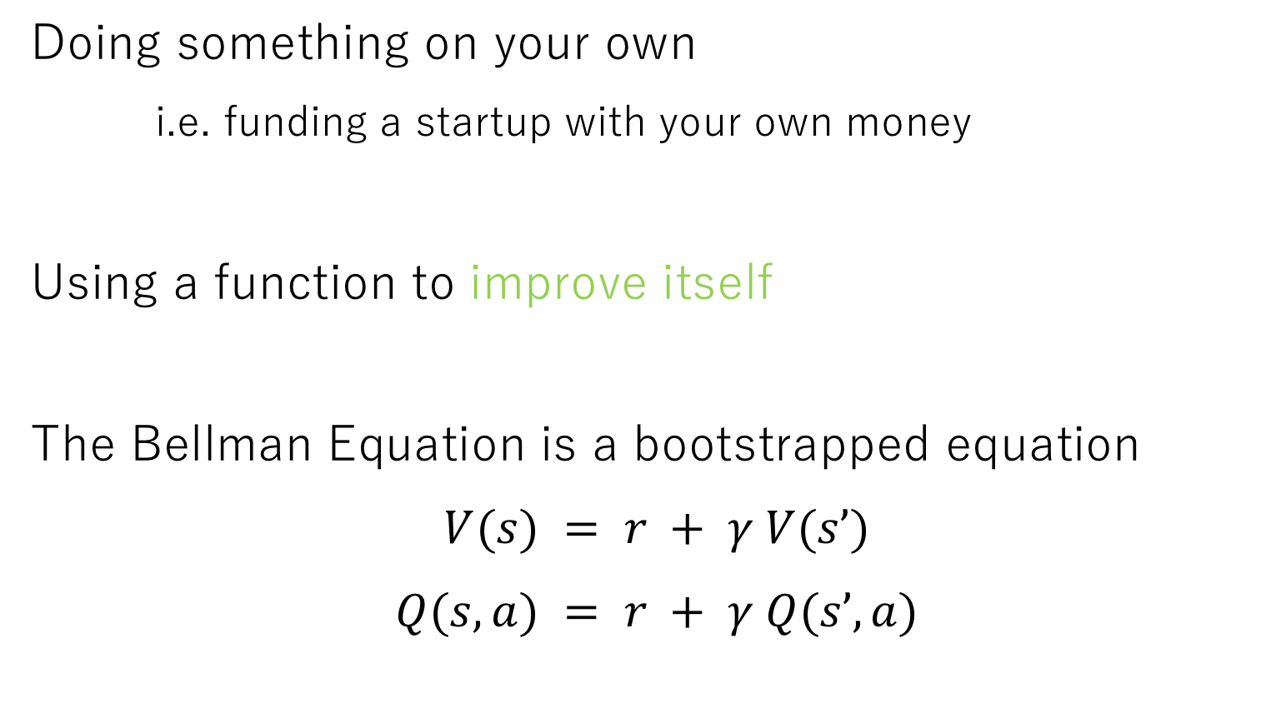
Bootstrapping
Doing something on your own
i.e. funding a startup with your own money
Using a function to improve itself
The Bellman Equation is a bootstrapped equation
$V(s) = r + γ V(s’)$
$Q(s,a) = r + γ Q(s’,a)$

Slide 14
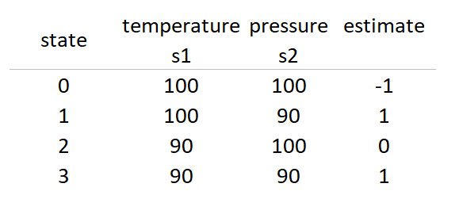
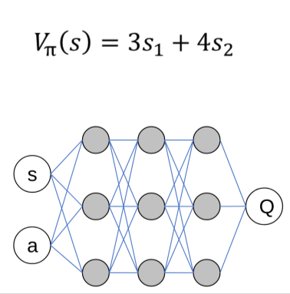
Function approximation
Lookup table
Linear function
Non-linear function
(neural network)

Slide 15
Lookup table
Advantages
stability
each estimate is independent of every other estimate (stability benefit)
Disadvantages
no aliasing between similar states
no sharing of knowledge between similar states or state actions
curse of dimensionality
need one entry per state – high dimensional state spaces means lots of entries

Slide 16
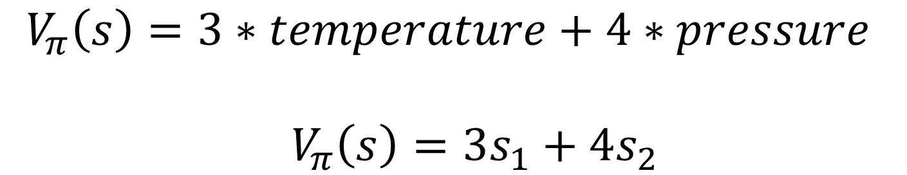
Linear function
$$V_{π}\left(s\right)=3∗temperature+4∗pressure$$
$V_{π}\left(s\right)=3s_{1}+4s_{2}$
Advantages
less parameters than a table
generalize across states
Disadvantages
many real world problems are non-linear

Slide 17
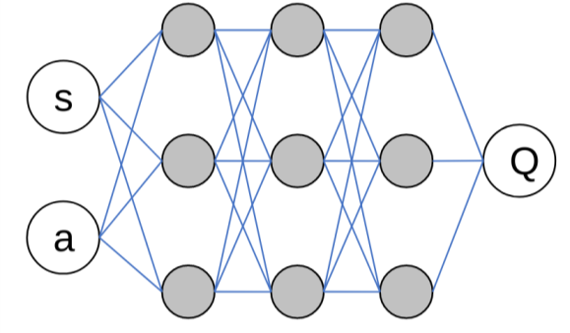
Non-linear function
Advantages
model complex dynamics
convolution for vision
recurrency for memory
Disadvantages
instability
difficult to train

Slide 18
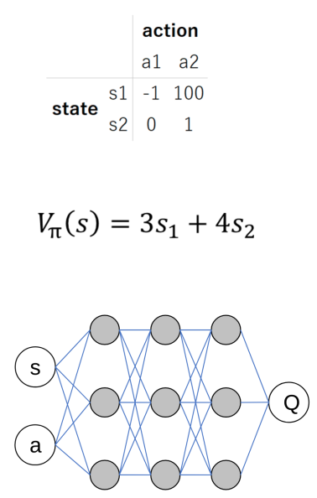
Function approximation
Lookup table
curse of dimensionality
Linear function
less parameters
generalize across states
Non-linear function
model complex dynamics
convolution for vision
recurrence for memory

Slide 19
iid
Fundamental assumption in statistical learning
independent and identically distributed
In statistical learning one always assumes the training set is independently drawn from a fixed distribution

Slide 20
Batch size
Modern reinforcement learning trains neural networks using batches of samples
1 epoch = 1 pass over all samples
i.e. 128 samples, batch size=64
-> two forward & backward passes across net

Slide 21
Batch training
Np.arrange(200).reshape(10, -1)
Train.reshape(10, 2, 10) (10 2x10 images)
Train.reshape(10, 5, 4) (10 5x4 images)

Slide 22
Batch size
Smaller batch sizes = less memory on GPU
Batches train faster – weights are updated more often for each epoch
The cost of using batches is a less accurate estimate of the gradient
this noise can be useful to escape local minima

Slide 23
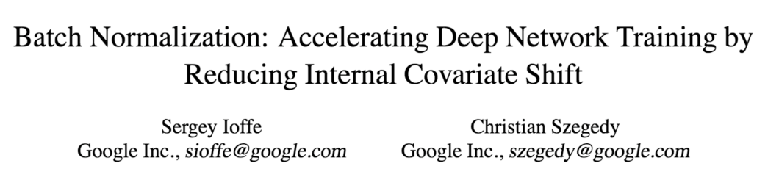
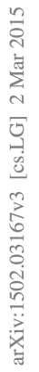
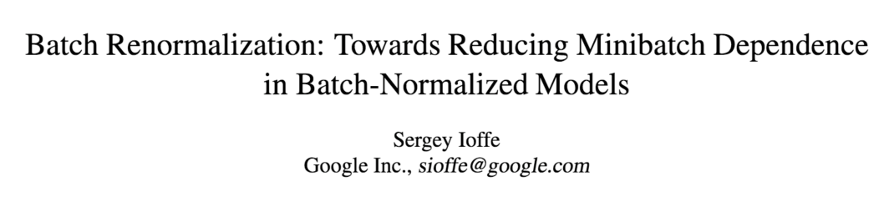
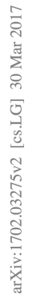
Batch normalization

Slide 24
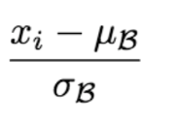
Batch norm.
Mean & variance of the batch is used to normalize activations
scaled_x = x – batch_mean / batch_variance
Keep the distribution of the layer inputs constant
Reduces sensitivity to weight & bias initialization
Can use higher learning rates

Slide 25
Batch renorm.
Vanilla batch norm. struggles with small or non-iid batches
Vanilla batch norm. uses two different methods for normalization for training & testing
Batch renormalization attempts to fix this by using a single algorithm for both training & testing

Slide 26
Quiz
Generalization error = ? + ? + ?
Variance = over/underfitting?
Bias = over/underfitting?

Slide 27
Quiz
Advantage of lookup table versus functions
Advantage of functions over lookup table
What is iid?
Vanilla batch norm. struggles with * or * batches – why?

Slide 28
Quiz
Generalization error = variance + bias + noise
Variance
overfitting
seeing patterns that aren’t there
Bias
underfitting
missing patterns

Slide 29
Quiz
Advantage of lookup table versus functions = stability
Advantage of functions over lookup table = less parameters
iid = independent & identically distributed
Vanilla batch norm. struggles with small or non-iid batches – because estimate of mean & std is harder

Slide 30
two
introduction to reinforcement learning

Slide 31
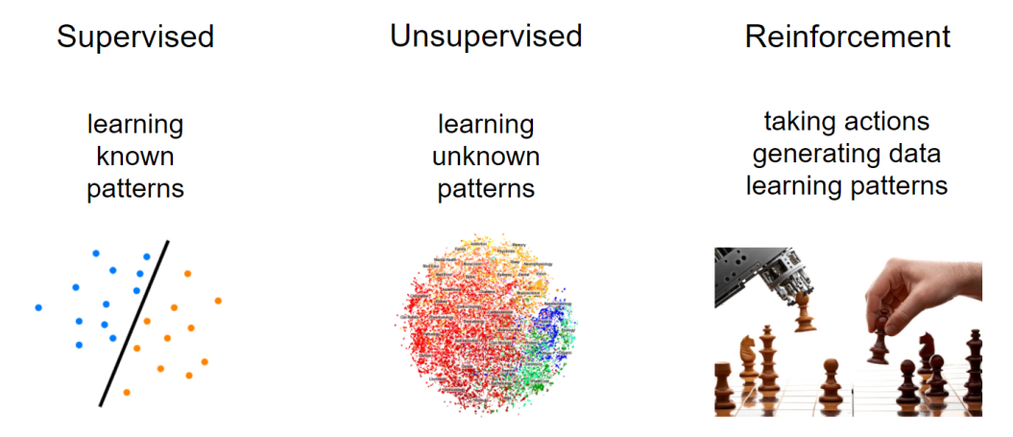
Machine learning
Random forests
Support vector machines
Feedforward neural net
Convolutional neural net
Recurrent neural net
Clustering algorithms
Generative adversarial nets (GANS)
Value function methods
Policy gradients
Planning (i.e. model based)

Slide 32
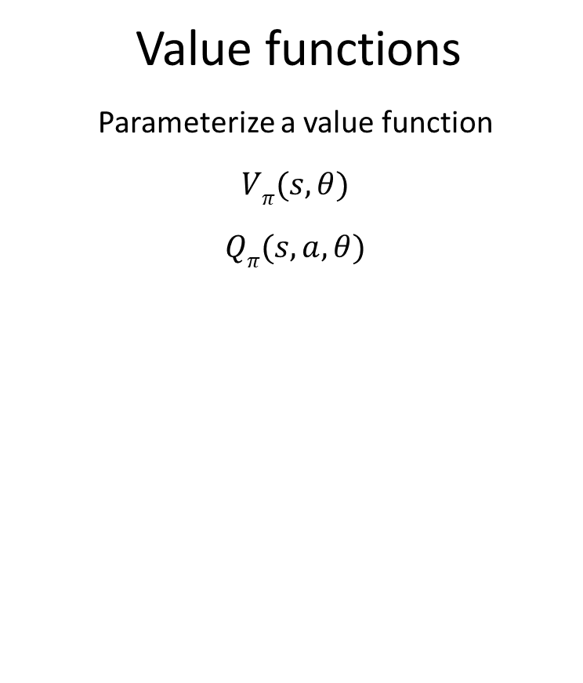
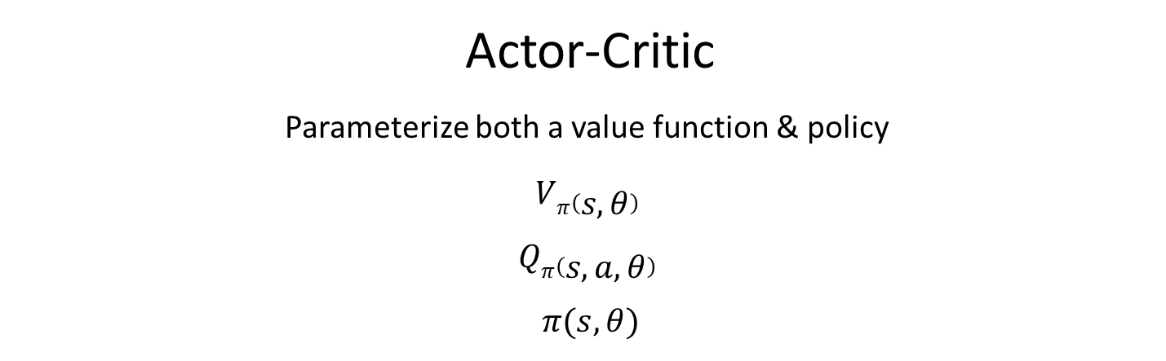
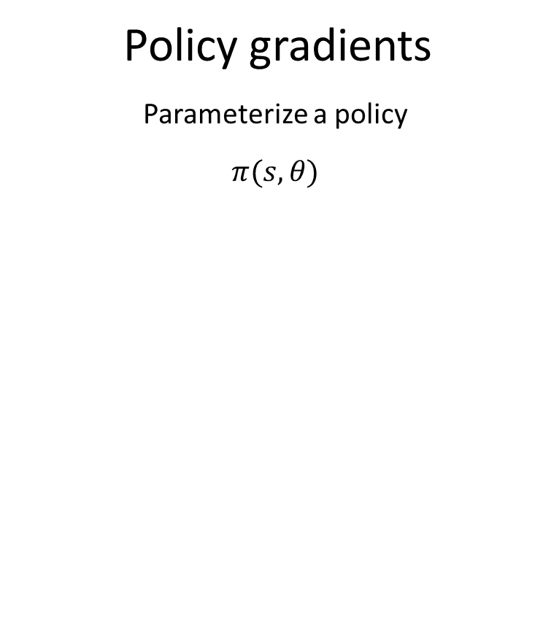
Model free reinforcement learning
Value functions
Parameterize a value function
$Vπ(s, θ)$
$Qπ(s, a, θ)$
Policy gradients
Parameterize a policy
$π(s, θ)$
Actor-Critic
Parameterize both a value function & policy
$Vπ\left(s, θ\right)$
$Qπ\left(s, a, θ\right)$
$π(s, θ)$

Slide 33
We won’t cover
Model based RL
model is used for planning
Evolutionary algorithms
non-gradient based approach
deal with sparse error signals
easily parallelizable
General optimization methods
i.e. cross entropy method

Slide 34
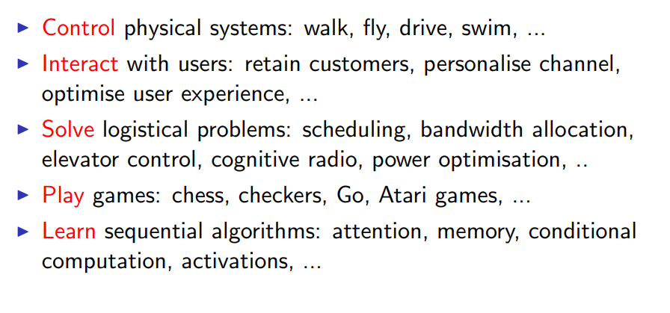
Applications – David Silver
David Silver – Deep Reinforcement Learning

Slide 35
Applications
robotics
self driving cars
smart contracts on blockchains
recommender systems
neural network design
manufacturing
energy

Slide 36
Reinforcement learning is not
NOT an alternative method to use instead of a random forest, neural network etc
“I’ll try to solve this problem using a convolutional nn or RL” this is nonsensical
Neural networks (supervised techniques in general) are a tool that reinforcement learners can use

Slide 37
Deep reinforcement learning
Deep learning
neural networks with multiple layers
Deep reinforcement learning
using multiple layer networks to approximate policies or value functions
Feedforward, convolutional or recurrent neural networks are all used

Slide 38
Reinforcement learning is learning through action

Slide 39
learns to maximise return
AGENT
state,
reward
action
ENVIRONMENT
responds to action

Slide 40
Agent & Environment
taking actions
Learn from data
learn to take
better actions
Generate data
experience
(s, a, r, s’)

Slide 41
Biological inspiration
Neurobiological evidence that reward signals during perceptual learning may influence the characteristics of representations within the primate visual cortex (Mnih et. al 2015)
Habit formation
Cue -> Routine -> Reward
State -> Action -> Reward

Slide 42
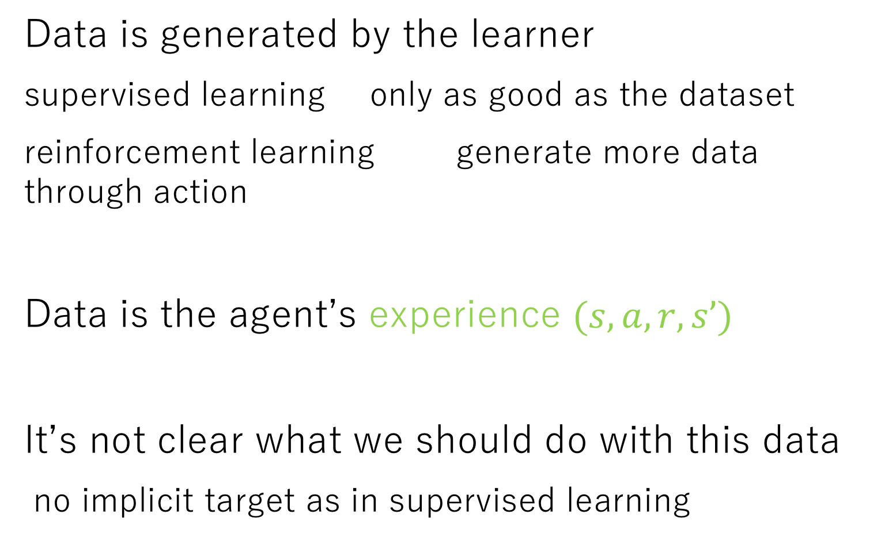
Data in reinforcement learning
Data is generated by the learner
supervised learning only as good as the dataset
reinforcement learning generate more data through action
Data is the agent’s experience $(s, a, r, s’)$
It’s not clear what we should do with this data
no implicit target as in supervised learning

Slide 43
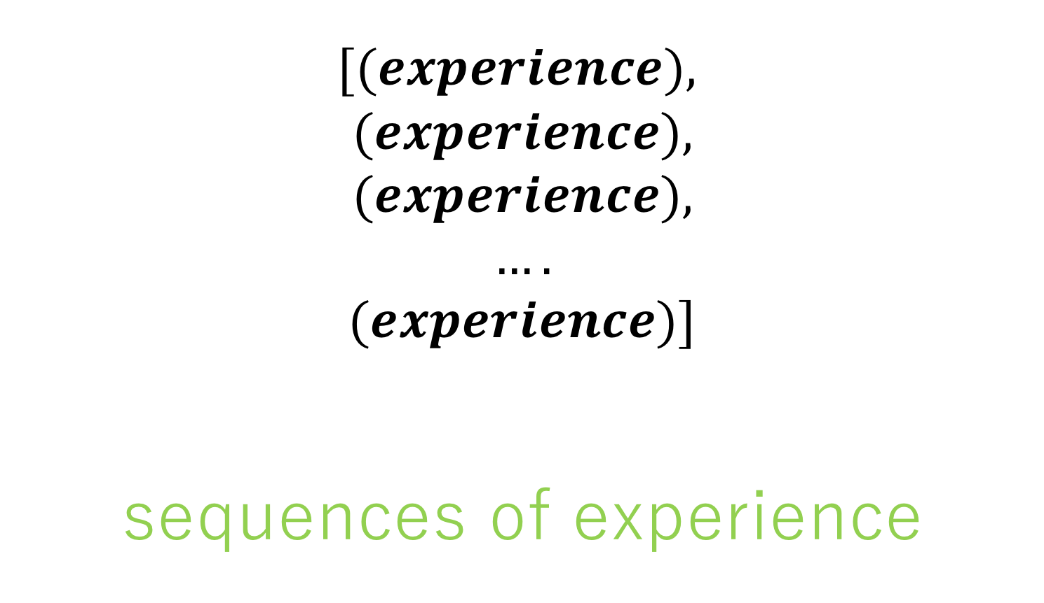
Reinforcement learning dataset
$$[(experience),$$
$$(experience),$$
$$(experience),$$
$$….$$
$$(experience)]$$
sequences of experience

Slide 44
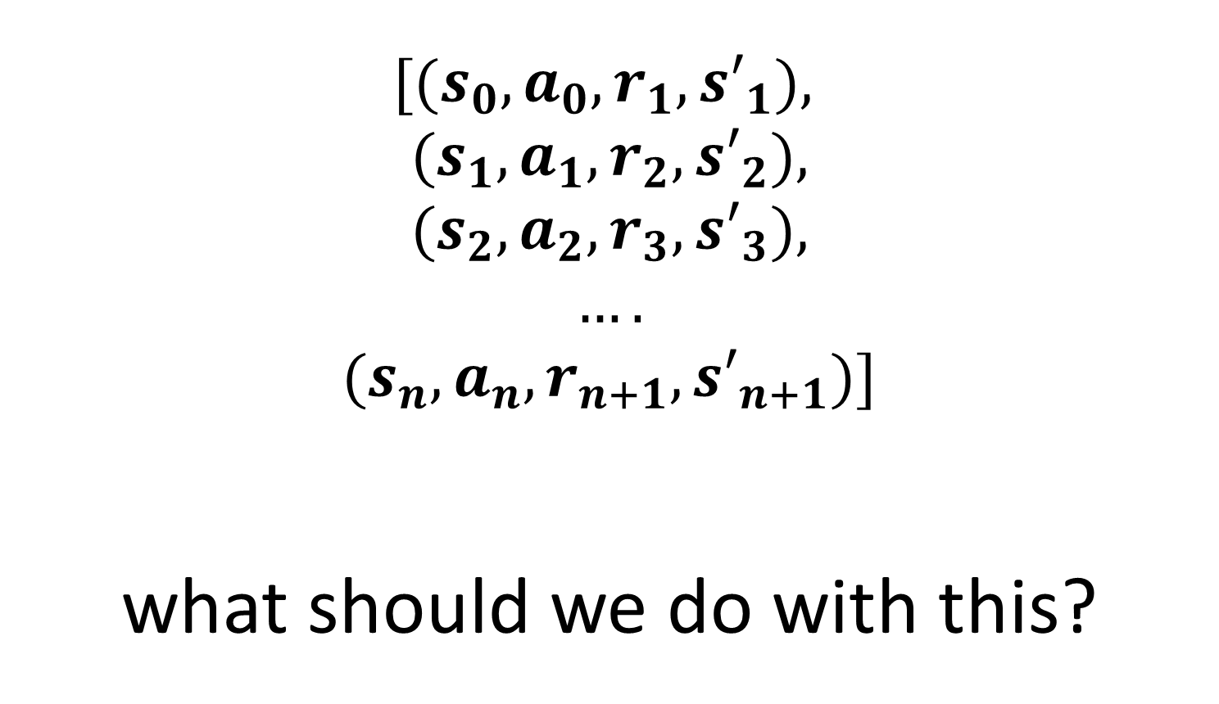
Reinforcement learning dataset
$$[(s_{0}, a_{0}, r_{1},{s′}_{1}),$$
$$(s_{1}, a_{1}, r_{2},{s′}_{2}),$$
$$(s_{2}, a_{2}, r_{3},{s′}_{3}),$$
$$….$$
$$(s_{n}, a_{n}, r_{n+1},{s′}_{n+1})]$$
what should we do with this?

Slide 45
Four challenges
one exploration vs exploitation
two data
three credit assignment
four sample efficiency

Slide 46
Exploration vs exploitation
Do I go to the restaurant in Berlin I think is best – or do I try something new?
Exploration = finding information
Exploitation = using information
Agent needs to balance between the two

Slide 47
Exploration vs exploitation
How stationary are the environment state transition and reward functions? How stochastic is my policy?
Design of reward signal vs. exploration required
Algorithm does care about the time step
too small = rewards are delayed = credit assignment harder

Slide 48
Data – correlated samples
All the samples collected on a given episode are correlated (along the state trajectory)
This breaks the iid assumption of independent sampling

Slide 49
Data – non-stationary distribution
Environment can be non-stationary
Learning changes the data we see
Exploration changes the data we see
All of these break the identically distributed assumption of iid

Slide 50
Reinforcement learning will always break supervised learning assumptions about data quality

Slide 51
Credit assignment
Which actions give us which reward
Reward signal is often
delayed benefit of action only seen much later
sparse experience with reward = 0
Sometimes we can design a more dense reward signal for a given environment

Slide 52
Sample efficiency
How quickly a learner learns
How often we reuse data
do we only learn once or can we learn from it again
on vs off policy
How much we squeeze out of data
i.e. learn a value function, learn a environment model

Slide 53
Four challenges
exploration vs exploitation
how good is my understanding of the range of options
data
biased sampling, non-stationary distribution
credit assignment
which action gave me this reward
sample efficiency
learning quickly, squeezing information from data

Slide 54
two
introduction to reinforcement learning
Markov Decision Processes

Slide 55
Markov Decision Processes
Mathematical framework for the reinforcement learning problem
A lot of theory (which we won’t cover today) proves that certain algorithms will converge to unbiased or optimal values in MDPs

Slide 56
Markov property
Future is conditional only on the present
Can make prediction or decisions using only the current state
Any additional information about the history of the process will not improve our decision

Slide 57
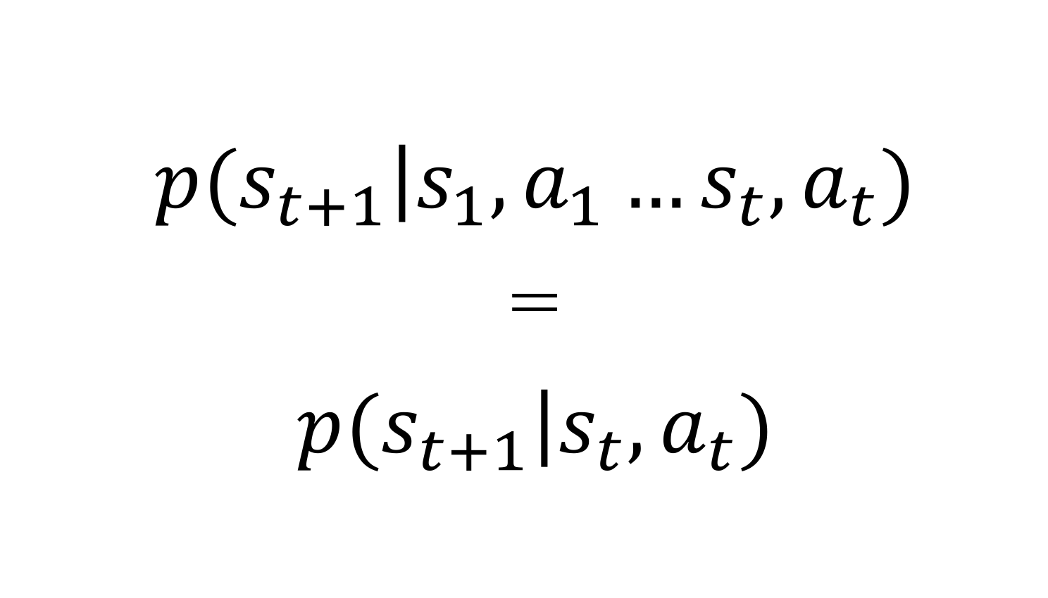
Markov property
$p(s_{t+1}\left|s_{1},a_{1}…s_{t},a_{t})\right.$
=
$p(s_{t+1}\left|s_{t},a_{t})\right.$

Slide 58
State vs observation
Not all problems are true MDPs
it’s more of an ideal - often unrealistic in practice
Often we are limited to partially observed MDPs
POMDP
the agent can only see some of the state variables
Lose convergence guarantees
still might be able to train a good agent

Slide 59
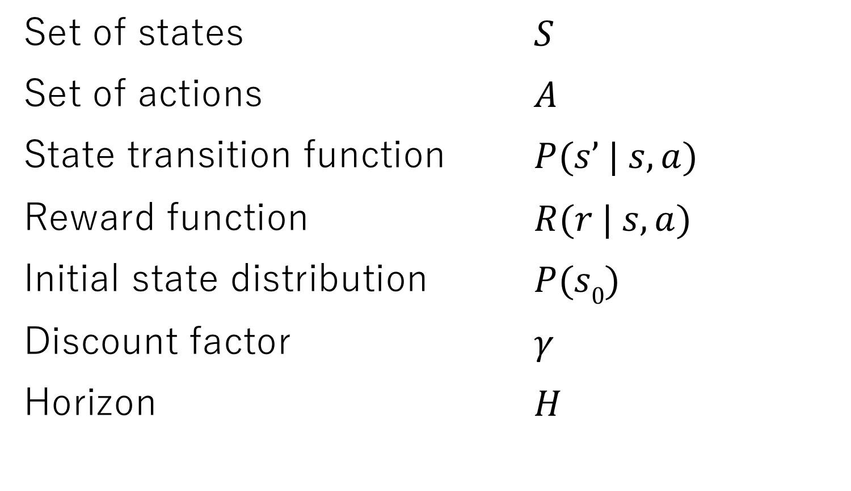
Formal definition of an MDP
Set of states $S$
Set of actions $A$
State transition function $P(s’ | s, a)$
Reward function $R(r | s, a)$
Initial state distribution $P(s0)$
Discount factor $γ$
Horizon $H$

Slide 60
Informal definition of an MDP
Two objects
agent + environment
Three signals
state, action, reward
agent
state,
reward
action
environment

Slide 61
Environment
Real or virtual
Discrete or continuous
action space
state space
Episodic vs. non-episodic
episodic is a special case of non-episodic (the absorbing state)
agent
state,
reward
state,
reward
action
environment

Slide 62

Discrete vs continuous spaces
Discrete action space
Continuous action space
Car accelerator from 0-100
We could discretize this as
[0, 1, 2, 3 … 99, 100]

Slide 63
Discrete vs continuous spaces
This can be a key consideration
some algorithms can only work with discrete spaces
Q-Learning requires a discrete action space to argmax across
Possible to discretize a continuous action space

Slide 64
Discretiziation
Too coarse
non-smooth control output
Too fine
curse of dimensionality
computationally expensive
Discretization requires some prior knowledge

Slide 65
State
Flexible concept
n-d array
Information for agent to
learn from
choose next action
Fully observed vs hidden
agent
state,
reward
action
environment

Slide 66
Reward
Flexible concept
scalar
delayed
sparse
agent
state,
reward
action
environment

Slide 67
Agent
Learner & decision maker
maximize cumulative discount reward
Agent always has a policy
even if it’s a bad one!
agent
state,
reward
action
environment

Slide 68
Reward Hypothesis
Maximising return is making an assumption about the nature of our goals
We are assuming that:
Goals can be described by the maximization of expected cumulative reward
Do you agree with this?

Slide 69

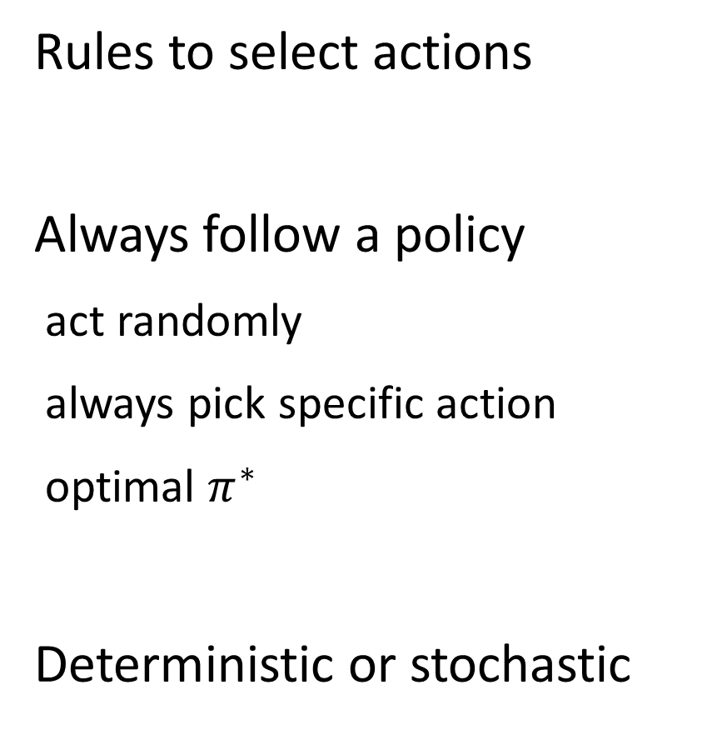
Policy - $π(s)$
Rules to select actions
Always follow a policy
act randomly
always pick specific action
optimal $π^{∗}$
Deterministic or stochastic
agent
state,
reward
action
environment

Slide 70

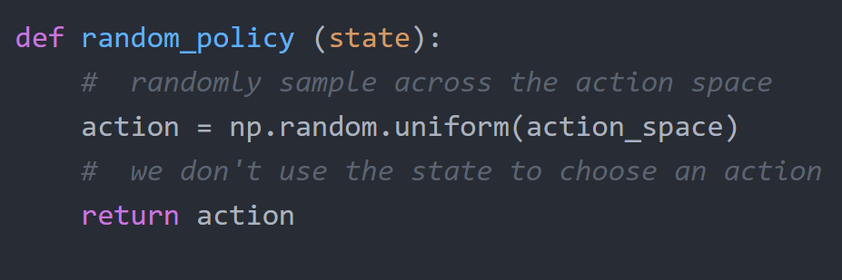

Random policy - $π(s)$

Slide 71
Policy - $π(s)$
Policy can be
parameterized directly (policy gradient methods)
generated from a value function (value function methods)
On vs. off-policy learning

Slide 72
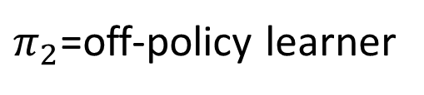
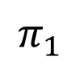
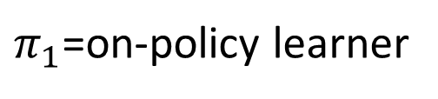
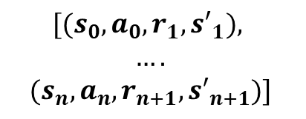
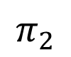
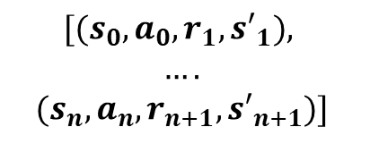
On vs off policy learning
$$π_{1}$$
$π_{1}$=on-policy learner
generates a dataset
by taking actions
$$[(s_{0}, a_{0}, r_{1},{s′}_{1}),$$
$$….$$
$$(s_{n}, a_{n}, r_{n+1},{s′}_{n+1})]$$
Can only learn
from this dataset
$$π_{2}$$
$π_{2}$=off-policy learner
generates a dataset
by taking actions
Can learn
from both datasets
$$[(s_{0}, a_{0}, r_{1},{s′}_{1}),$$
$$….$$
$$(s_{n}, a_{n}, r_{n+1},{s′}_{n+1})]$$

Slide 73
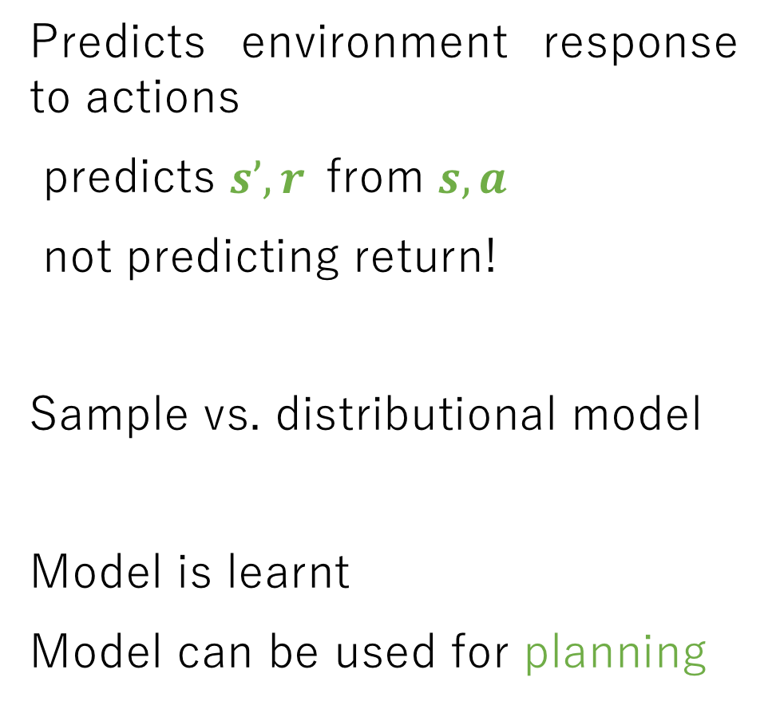
Environment model
Predicts environment response to actions
predicts $s’, r$from $s, a$
not predicting return!
Sample vs. distributional model
Model is learnt
Model can be used for planning
agent
state,
reward
action
environment

Slide 74
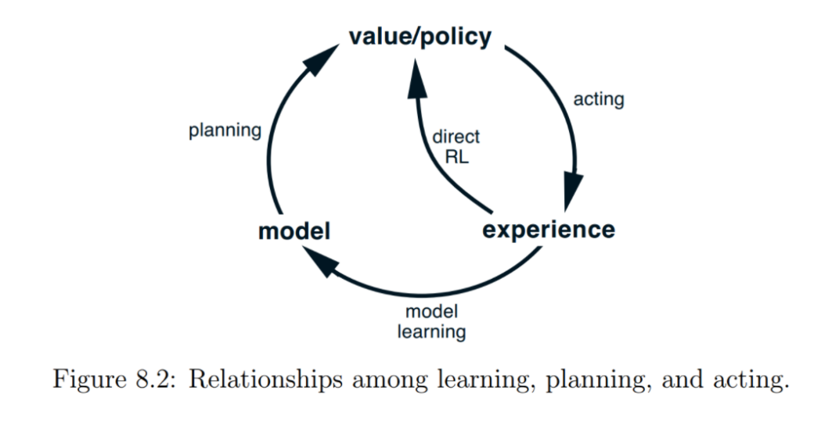
Sutton & Barto

Slide 75
learns to maximise return
AGENT
policy π(s)
value function(s) V_{π}(s), Q_{π}(s, a)
environment model(s)
state s,
reward r
action a
ENVIRONMENT
state transition P(s’ | s, a)
reward transition R(s, a, s’)
responds to action

Slide 76
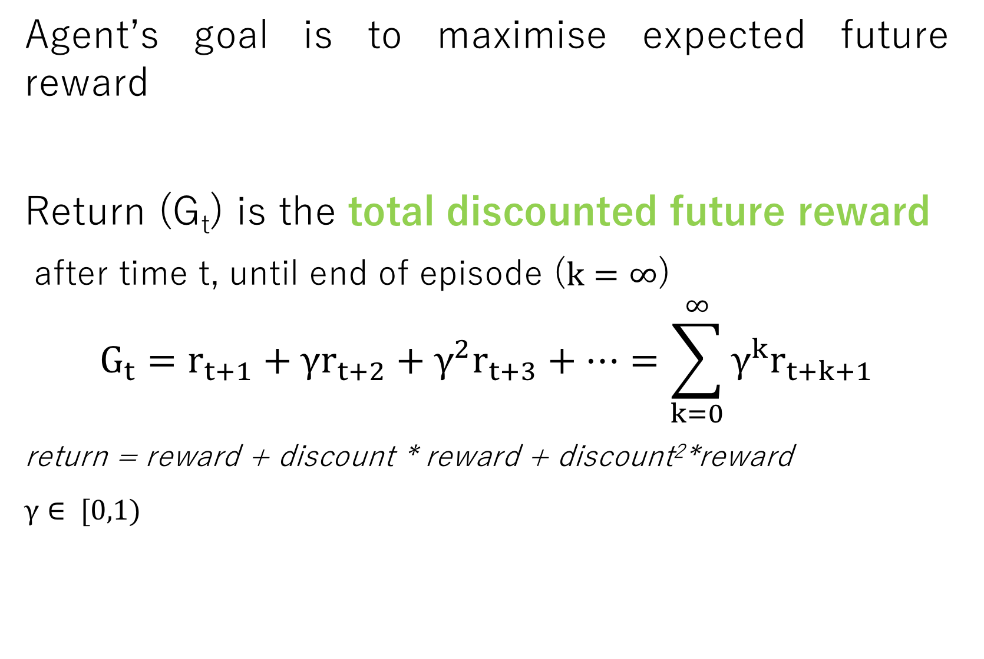
Return
Agent’s goal is to maximise expected future reward
Return (G_{t}) is the total discounted future reward
after time t, until end of episode ($k=∞$)
$$G_{t}=r_{t+1}+γr_{t+2}+γ^{2}r_{t+3}+…=\sum_{k=0}^{∞}{γ^{k}r_{t+k+1}}$$
return = reward + discount * reward + discount²*reward
$γ∈ [0,1)$

Slide 77
Why would we discount future rewards?

Slide 78
Discounting
Future is uncertain
stochastic environment
Matches human thinking
hyperbolic discounting
Finance
time value of money

Slide 79
Discounting
https://www.jair.org/media/5507/live-5507 10333-jair.pdf
Makes return for infinite horizon problems finite
an infinite series with a finite sum (geometric series)
for discount [0,1)
Many games with tree-like structures (without cycles) can use a discount of 1. Also when time to solve is irrelevant (ie a board game)
https://www.jair.org/media/5507/live-5507-10333-jair.pdf

Slide 80
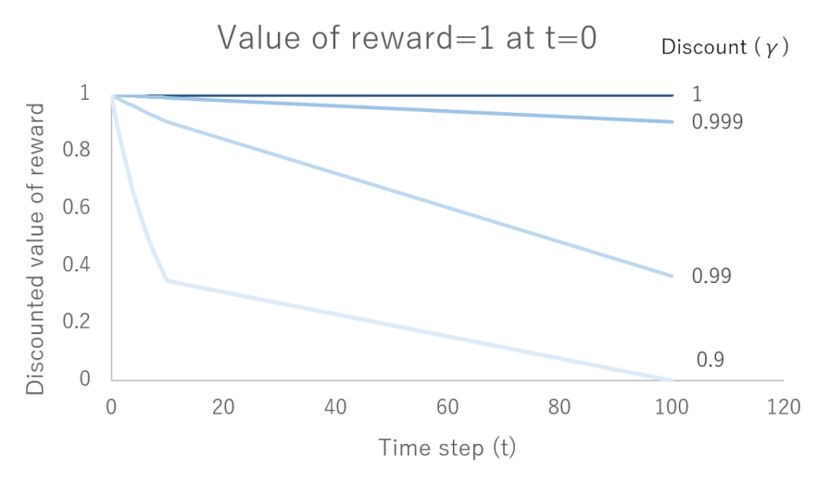
How much is a reward of 1 worth after t time steps

Slide 81
break

Slide 82
recap quiz
Two objects ?
Three signals ?
Policy ?
Model ?
Return ?

Slide 83
recap
Two objects agent & environment
Three signals state, reward & action
Policy rules to select actions
Model predicts next state & reward
Return future discounted reward

Slide 84
three - value function methods
introduction to value functions
Bellman equation

Slide 85
Value function
how good is this state
Action-value function
how good is this action

Slide 86
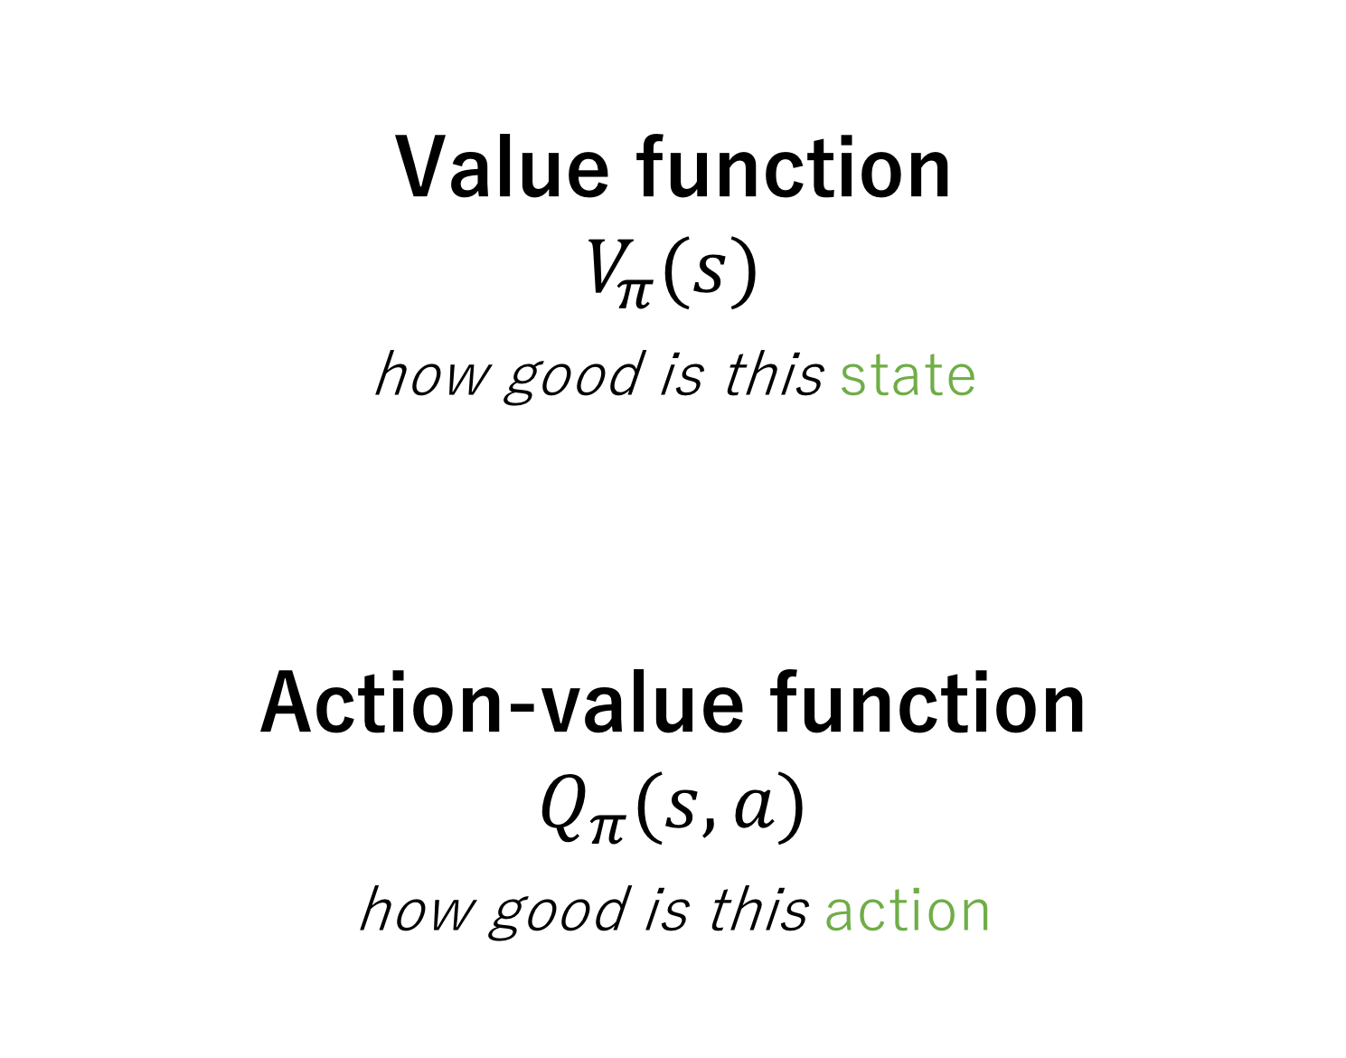
Value function
$$V_{π}(s)$$
how good is this state
Action-value function
$$Q_{π}(s,a)$$
how good is this action

Slide 87
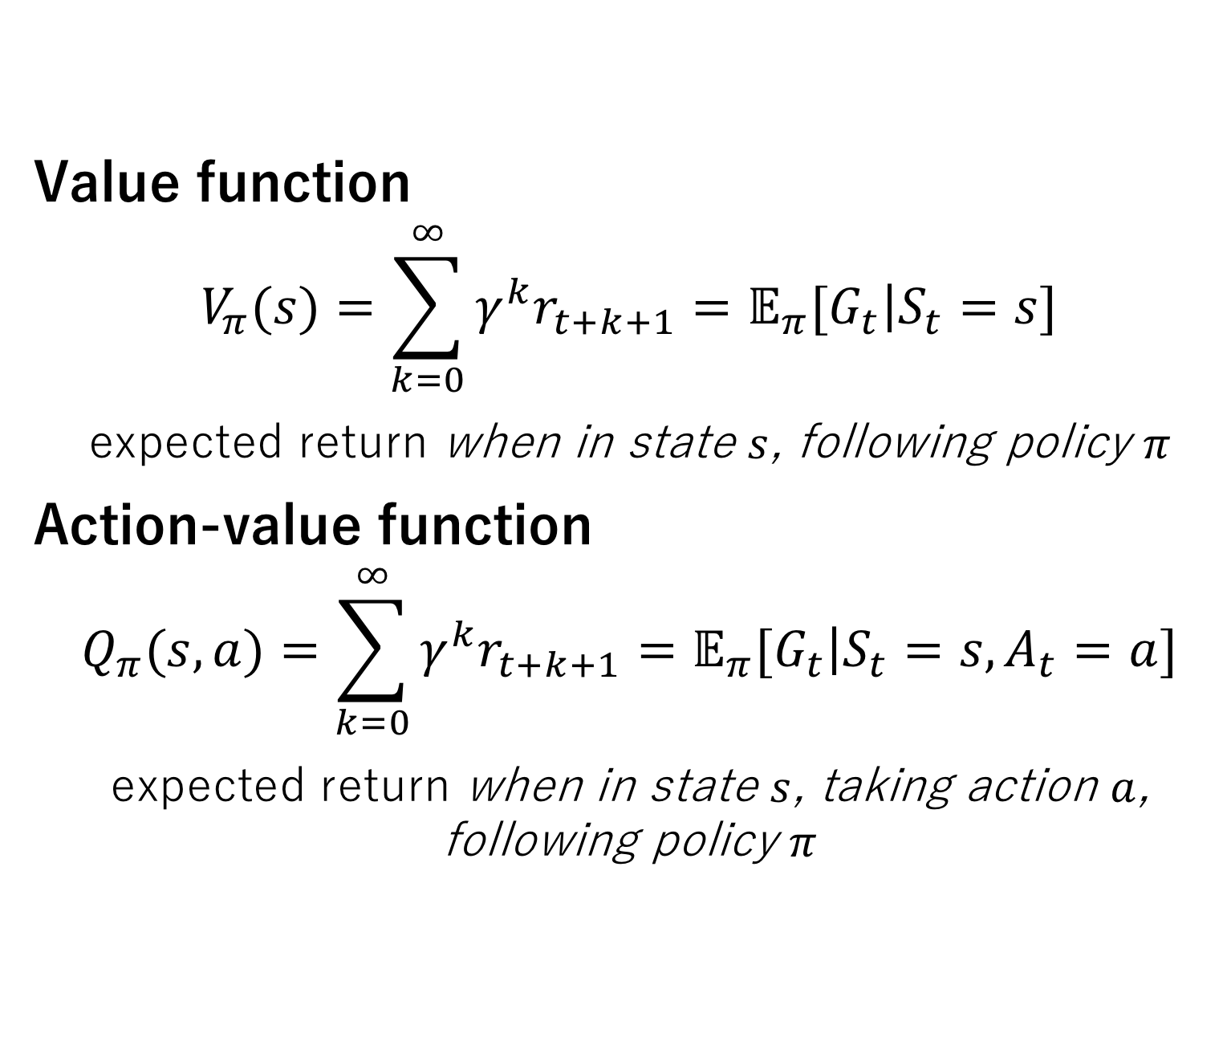
Value functions
Value function
$$V_{π}(s)=\sum_{k=0}^{∞}{γ^{k}r_{t+k+1}=𝔼_{π}[\left.G_{t}\right|S_{t}=s]}$$
expected return when in state $s$, following policy $π$
Action-value function
$$Q_{π}(s,a)=\sum_{k=0}^{∞}{γ^{k}r_{t+k+1}}=𝔼_{π}[\left.G_{t}\right|S_{t}=s,A_{t}=a]$$
expected return when in state $s$, taking action $a$, following policy $π$

Slide 88
Value functions
Value functions are predictions of the future
prediction of return
prediction of future expected discounted reward
always conditioned on a policy
But we don’t know this function
agent must learn it
once we learn it – how will it help us to act?

Slide 89
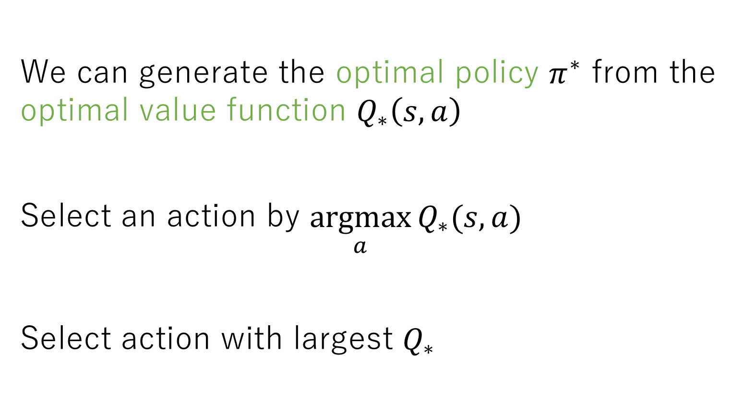
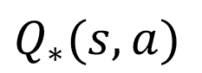
Generating a policy from a value function
We can generate the optimal policy $π^{∗}$ from the optimal value function $Q_{∗}\left(s,a\right)$
Select an action by $\underset{a}{argmax}{Q_{∗}(s,a)}$
Select action with largest $Q_{∗}$
s
a₁
a₂
a₃
$$Q_{∗}(s,a)$$
3
4
5

Slide 90
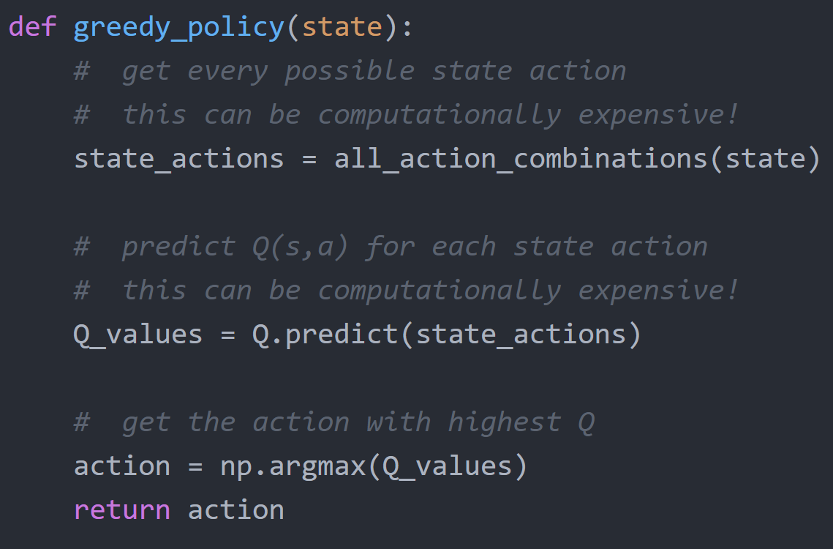

Greedy policy - $π(s)$

Slide 91
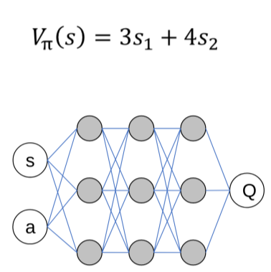
Value function approximation
Lookup table
curse of dimensionality
Linear function
less parameters
generalize across states
Non-linear function
model complex dynamics
convolution for vision
recurrency for memory

Slide 92

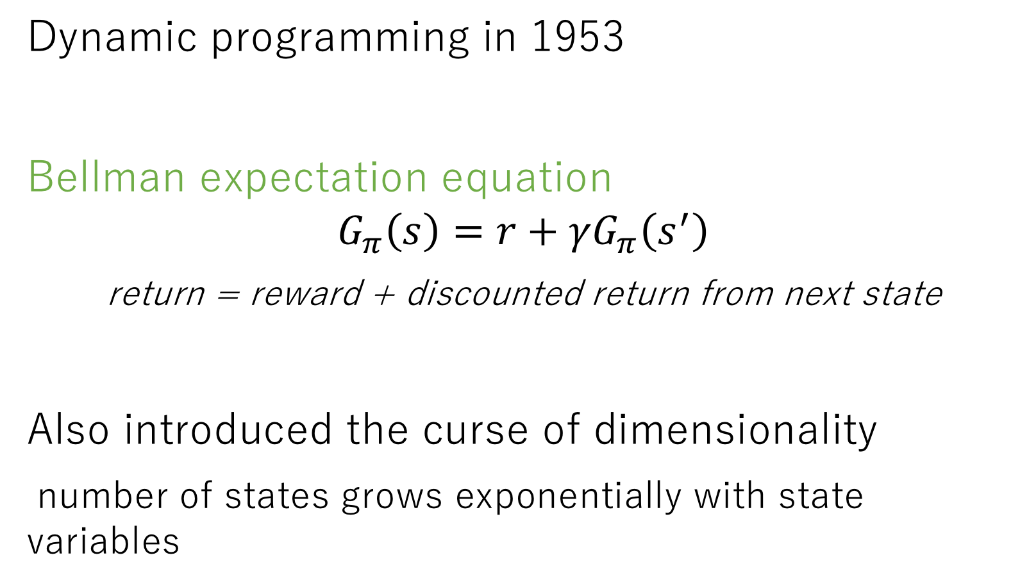
Richard Bellman
Dynamic programming in 1953
Bellman expectation equation
$$G_{π}\left(s\right)=r+γG_{π}\left(s^{′}\right)$$
return = reward + discounted return from next state
Also introduced the curse of dimensionality
number of states grows exponentially with state variables

Slide 93
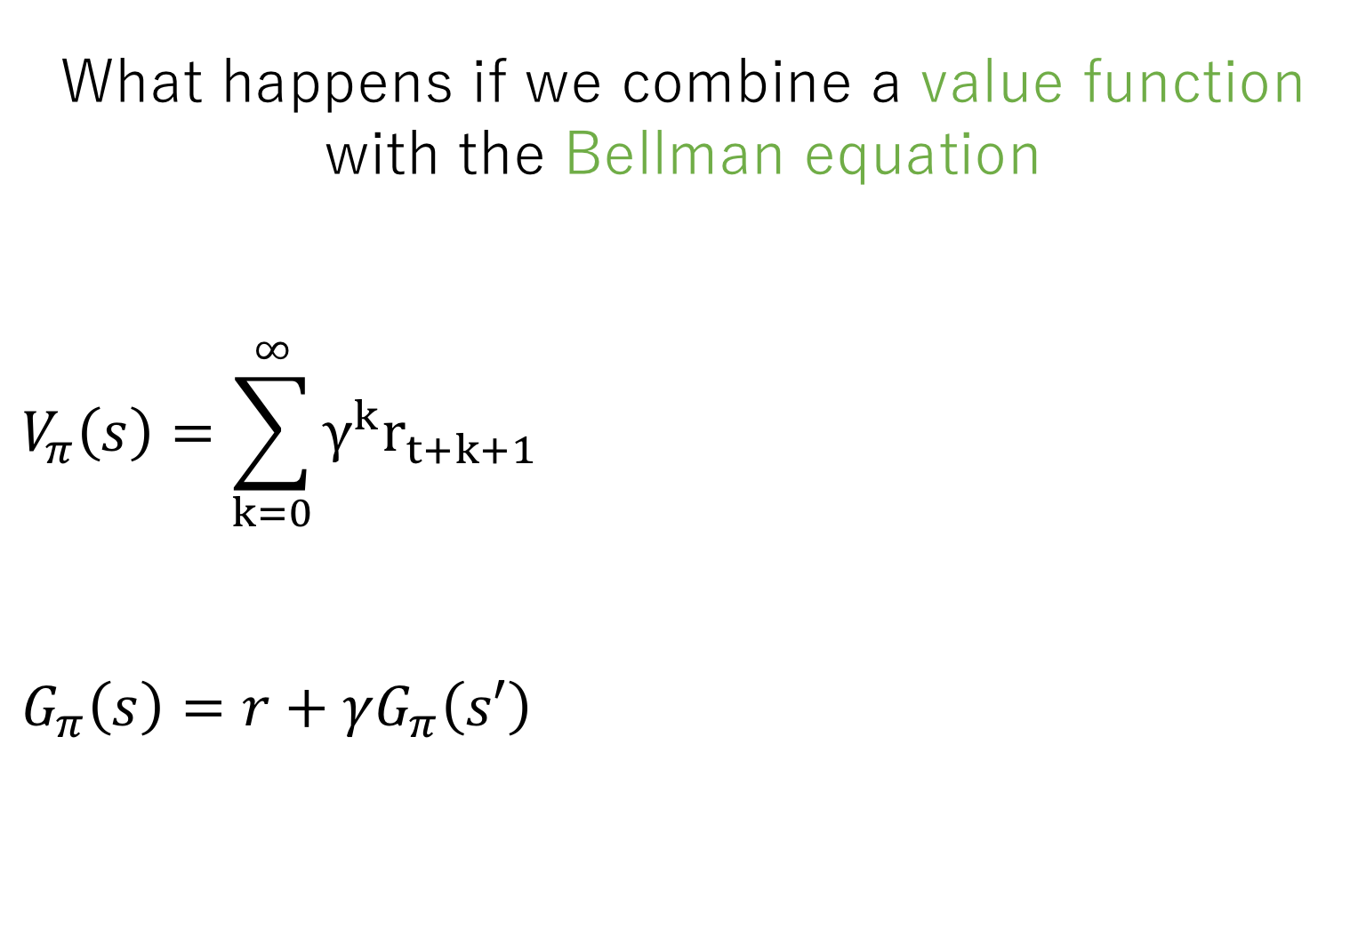
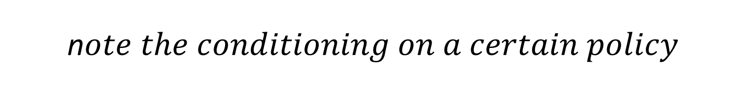
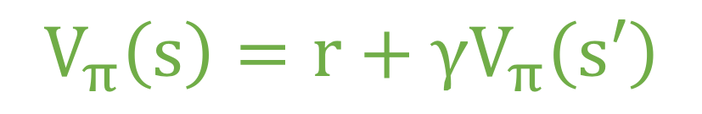
What happens if we combine a value function with the Bellman equation $$V_{π}\left(s\right)=\sum_{k=0}^{∞}{γ^{k}r_{t+k+1}}$$ $$G_{π}\left(s\right)=r+γG_{π}\left(s′\right)$$
$$V_{π}\left(s\right)=r+γV_{π}\left(s′\right)$$
n$ote the conditioning on a certain policy$

Slide 94
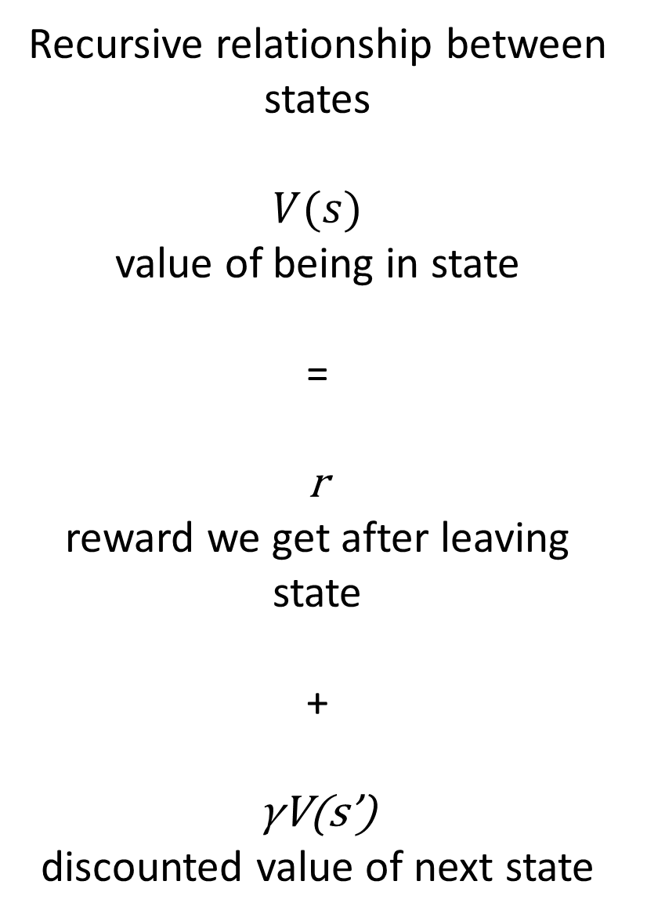
Recursive relationship between states $$V(s)$$ value of being in state = r reward we get after leaving state + γV(s’) discounted value of next state
s
state
r
s’
next state

Slide 95
Why is the Bellman equation important?

Slide 96
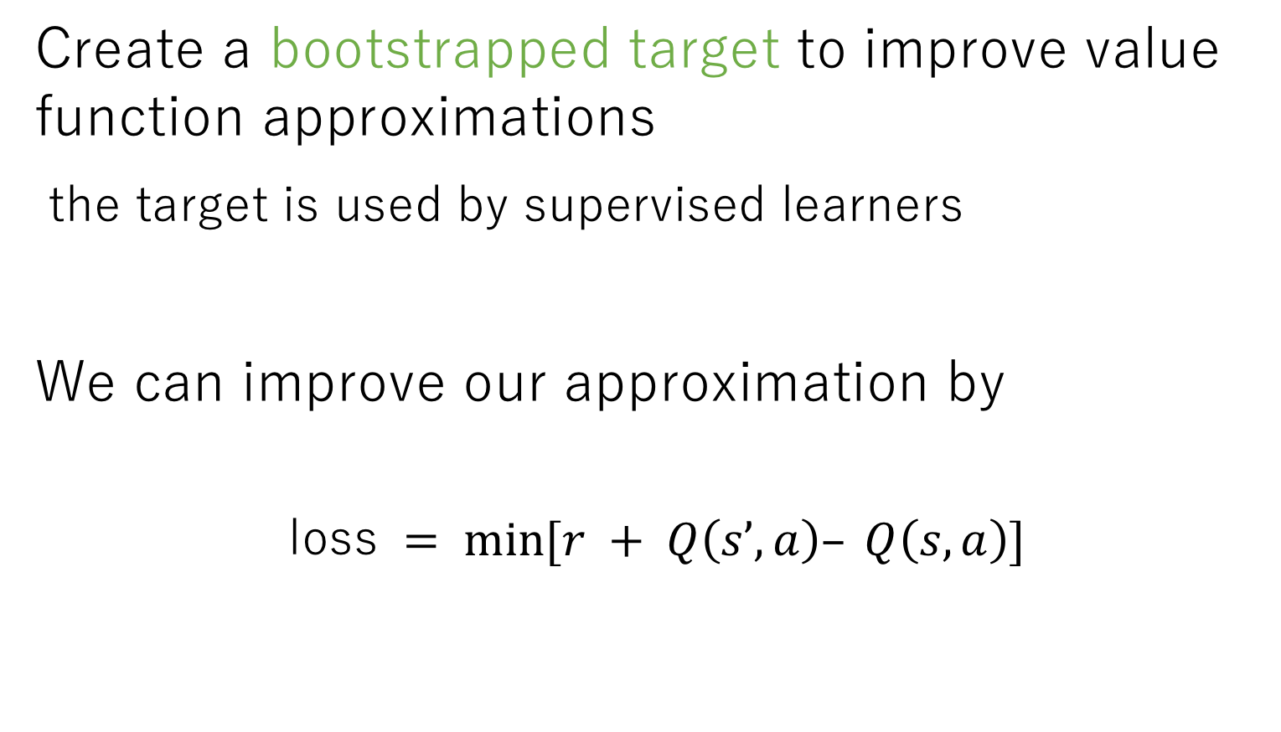
Bellman equation
Create a bootstrapped target to improve value function approximations
the target is used by supervised learners
We can improve our approximation by
$$\text{loss} = min⁡[r + Q\left(s’,a\right)– Q\left(s,a\right)]$$
target
current function
approximation

Slide 97
Bellman equation
Value function approximation is crucial for policy improvement
Policy approximation vs policy improvement
prediction vs control
Two problems
1 improving our approximation of the value function
2 improving our policy (ie our actions)

Slide 98
Prediction, control, planning
The prediction problem, or policy evaluation, is to compute the state or action value function for a policy
The control problem is to find the optimal policy
Planning constructs a value function or a policy with a model

Slide 99
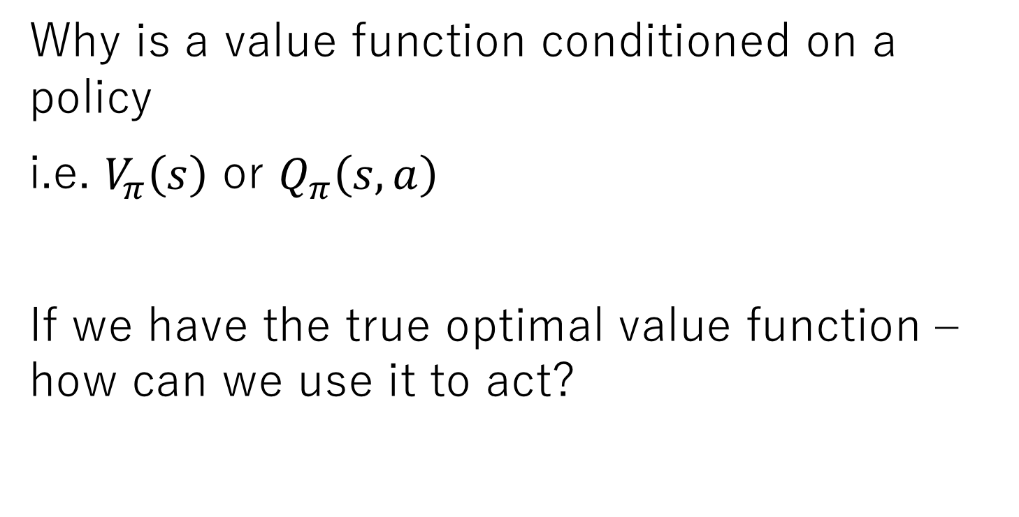
recap quiz
Why is a value function conditioned on a policy
i.e. $V_{π}\left(s\right)$ or $Q_{π}\left(s,a\right)$
If we have the true optimal value function – how can we use it to act?

Slide 100

Approximation & improvement
Three different methods for approximation (there are more!)
dynamic programming
Monte Carlo
temporal difference
One method for policy improvement
change policy to favour the best action
Sutton & Barto

Slide 101
three – value function methods
introduction to value functions & Bellman equation
value function approximation
dynamic programming

Slide 102

Dynamic programming
Imagine we had access to a perfect environment model
know state transition probabilities $P(s|s’, a)$
know the reward function $R(s, a, s’)$
How would you use this perfect environment model for value function approximation?
use the Bellman equation

Slide 103
Dynamic programming backup
s1
Random policy
Discount = γ = 0.9
r = 1
p = 50%
r = 2
p = 50%
s2
s3
r = 5
p = 100%
s4
The state transition probabilities p depend both on the environment & policy

Slide 104

Dynamic programming backup
We can now perform iterative backups of the value of each state backwards in time
note – return for all terminal states are zero
$$V\left(s_{4}\right)=0$$
$$V(s_{2})=0$$
$$V\left(s_{3}\right)=P_{34}\left[r_{34}+γV\left(s_{4}\right)\right]$$
$$V\left(s_{1}\right)=P_{12}\left[r_{12}+γV\left(s_{2}\right)\right]+P_{13}\left[r_{13}+γV\left(s_{3}\right)\right]$$

Slide 105

Dynamic programming backup
$$V\left(s_{4}\right)=0$$
$$V(s_{2})=0$$
$$V\left(s_{3}\right)=P_{34}\left[r_{34}+γV\left(s_{4}\right)\right]=1∗\left[5+0.9∗0\right]=5$$
$$V\left(s_{1}\right)=P_{12}\left[r_{12}+γV\left(s_{2}\right)\right]+P_{13}\left[r_{13}+γV\left(s_{3}\right)\right]$$
$$V\left(s_{1}\right)=0.5∗\left[1+0.9∗0\right]+0.5∗\left[2+0.9∗5\right]=3.75$$

Slide 106


Dynamic programming
Sutton & Barto
Value function estimate $V(s)$depends on
our policy (what action we pick in state s)
the environment model (state & reward transitions)
our estimate of $V(s’)$(bootstrapping)

Slide 107
Dynamic programming
Sutton & Barto
V(s) depends on on the value of all possible s’
even when P(s|s’, a)=0
Computationally expensive – every state is backed up by every other state

Slide 108
Dynamic programming
Requires a perfect environment model
we don’t learn from experience at all!
Bootstrapped
value function improves itself
Reliable convergence for tabular value function, finite, fully observed MDPs

Slide 109
three – value function methods
introduction to value functions & Bellman equation
value function approximation
dynamic programming
Monte Carlo

Slide 110

Monte Carlo
No model – learn from actual experience
experience = sequences of $(s, a, r, s’)$
No bootstrapping
$V(s)$= average of true discounted returns experienced
Episodic only
because we need to know the true discounted return
no within episode learning

Slide 111

Monte Carlo
Estimate value of state by averaging returns observed after visit to that state
estimate by sampling observed returns
As more episodes run, estimate should converge to the expected value
expected return of state $s$ following policy $π$
Low bias & high variance – why?

Slide 112
Monte Carlo
High variance
we need to sample enough episodes for our averages to converge
can be a lot for stochastic or path dependent environments
Low bias
we are using actual experience
no chance for a bootstrapped function to mislead us

Slide 113

Monte Carlo
David Silver

Slide 114


Interesting thing about Monte Carlo
Computational expense of estimating the value of state $s$ is independent of the number of states $S$
this is because we use experienced state transitions
s1
$$G\left(s_{4}\right)=0$$
$$G\left(s_{3}\right)=5+0.9∗0$$
$$G\left(s_{1}\right)=2+0.9∗5$$
r = 2
s2
s3
s4
r = 5

Slide 115
Monte Carlo
Learn from actual experience – no environment model
No bootstrapping – use true discounted returns
Episodic problems only – no learning online
High variance, low bias

Slide 116
three – value function methods
introduction to value functions & Bellman equation
value function approximation
dynamic programming
Monte Carlo
temporal difference

Slide 117
Temporal difference
Learn from actual experience – no environment model
Bootstrap – learn online
Episodic & non-episodic problems
Usually converges faster than Monte Carlo

Slide 118


Temporal difference
Estimate bootstrap the approx. of $V(s)$ using $V(s’)$
like dynamic programming
Sample from experienced trajectories
like Monte Carlo
TD(0)

Slide 119

TD(0) backup
s1
r = 2
s2
s3
s4
r = 5
$$V\left(s_{1},θ_{i+1}\right)=V\left(s_{1}θ_{i}\right)+α\left[r_{23}+γV\left(s_{3}{,θ}_{i}\right)−V\left(s_{1}{,θ}_{i}\right)\right]$$
Bootstrapping
Using the experienced trajectory

Slide 120

TD(0) algorithm
Ref = Li (2017)

Slide 121

Linking together
Temporal difference & Monte Carlo are two extremes of the same scale
Bias-variance tradeoff
Further reading
n-step methods
TD(λ)
Eligibility traces
bias
variance
Sutton & Barto

Slide 122

look ahead only one step – but only the experienced next state
look ahead only one step – but at every possible next state
look ahead all the way to the end– but only the experienced next states
look ahead all the way to the end AND
every possible next state
The Long-term of AI & Temporal-Difference Learning – Rich Sutton

Slide 123

λ = 0 = TD(0)
λ = 1 = full Monte Carlo
Conclusion – full Monte Carlo isn’t very good!
The Long-term of AI & Temporal-Difference Learning – Rich Sutton

Slide 124
break

Slide 125

recap quiz
Why can’t Monte Carlo learn online (i.e. within episode)?

Slide 126
recap quiz
Dynamic programming
environment model, bootstraps
Monte Carlo
model free, samples actual returns, episodic only
Temporal difference
model free, bootstraps, samples actual experience

Slide 127

recap
Sutton & Barto

Slide 128
three – value functions
policy improvement & control
Q-Learning
DeepMind Atari work

Slide 129


Slide 130


Slide 131
Q-Learning
Popular modern method for reinforcement learning
first introduced in 1988/89 (Watkins)
Historically was unstable with non-linear function approximators
DeepMind used experience replay & target networks to improve learning stability

Slide 132
Why Q-Learning?

Slide 133


$V(s)$ vs $Q(s, a)$
Both model future expected discounted return
Which is more useful?
$V(s)$tells us how good a state is
doesn’t tell us how to get there
$Q(s, a)$tells us how good an action is

Slide 134

SARSA & Q-Learning
Both temporal difference methods
SARSA
on-policy – policy approximation
experienced state, action, reward, next state, next action

Slide 135

SARSA & Q-Learning
Q-Learning
off policy – policy improvement / control
experienced state, action, reward, next state
max across all actions from next state

Slide 136

SARSA & Q-Learning
Sutton & Barto

Slide 137
Q-Learning
Discrete action spaces only
argmax across all possible actions
Deterministic policy
we always pick the best action
How do we get exploration in Q-Learning?

Slide 138



$ε$-greedy exploration
$argmax[Q\left(s,a\right)]$is deterministic
Use $ε$-greedy exploration to explore state space
$ε$ decayed as learning improves greedy action selection

Slide 139



Problems with vanilla Q-Learning
$$r+γ\max_{a′}{Q(s^{′},a^{′};θ_{i}) −Q\left(s,a;θ_{i}\right)}$$
$$target$$
$$network$$
$$output$$
Can be hard to get working
correlations in the data (state sequences)
small updates to weights may change the policy drastically
But if it works, works really well
sample efficient

Slide 140
Deadly triad
1 - Off policy learning
to free behaviour policy from target policy
2 - Function approximation
scalability & generalization
3 - Bootstrapping
computational & data efficiency (trade variance for bias)
Combine to produce instability & divergence
Sutton & Barto

Slide 141
Deadly triad
Unclear which is the root cause for instability
dynamic programming can diverge with function approximation
prediction can diverge (so it’s not exploration or control)
linear functions can be unstable (not non-linear functions)
It’s the combination of the three

Slide 142
DeepMind Atari work
DQN = Deep Q-Network
Mnih et. al (2013) Playing Atari with Deep Reinforcement Learning
Mnih et. al (2015) Human-level control through deep reinforcement learning
Two key techniques to improve stability
1 – experience replay (Lin 1993)
2 – target network

Slide 143
Significance
End to end deep reinforcement learning
learning from high dimensional input
raw pixels & convolutional neural network
Ability to generalize
same algorithm, network structure and hyperparameters
intentionally sacrifice performance for ability to generalize

Slide 144

Reinforcement learning to play Atari
State = last four screens
allows information about movement
grey scale, cropped
Reward = game score
clipped to [-1,1]
Actions = joystick buttons (a discrete action space)

Slide 145

superhuman

Slide 146

Value function approximation
One forward pass to estimate $Q(s,a)$for all $a$

Slide 147


Agent sees new enemy
Value function gets excited
Agent has fired torpedo
Value function is very excited
Reward received
Value function back to normal

Slide 148


Experience replay
Sample
uniform
random
Replay buffer
$$[(s_{0}, a_{0}, r_{1},{s′}_{1}),$$
$$(s_{1}, a_{1}, r_{2},{s′}_{2}),$$
$$(s_{2}, a_{2}, r_{3},{s′}_{3}),$$
$$….$$
$$(s_{n}, a_{n}, r_{n+1},{s′}_{n+1})]$$
Training targets
$[Q\left(s_{0,}{ a}_{0}\right)=r_{1}+\underset{a}{γ max}{Q(s_{1},a)}$,
….,
$Q\left(s_{2,}{ a}_{2}\right)=r_{3}+\underset{a}{γ max}{Q(s_{3},a)}$]
Trained using batches of 32-64 random samples
Memory of last 1 million frames

Slide 149

Experience replay
Averaging of behavior distribution
more independent sampling
avoids the within trajectory correlation of$s$to $s’$
breaking correlations in data
Data efficiency
learn from experience multiple times
Allows seeding with human expert experience

Slide 150
Biological inspiration
Hippocampus may support an experience replay process in the brain
Time compressed reactivation of recently experienced trajectories during offline periods
Provides a mechanism where value functions can be efficiently updated through interactions with the basal ganglia
Minh et. al (2015)

Slide 151

Prioritize training on experiences with high temporal difference error
Balance between greedy replay (on TD error) vs uniform random (like vanilla experience replay)
Faster learning – and also less i.i.d learning

Slide 152



Target network
$$L_{i}\left(θ_{i}\right)= 𝔼_{(s,a,r,s^{′})\sim U(D)}\left[{r+γ\max_{a′}{Q(s^{′},a^{′};θ_{i}^{−}) −Q\left(s,a;θ_{i}\right)}}^{2}\right]$$
$$target$$
$$approx.$$
Second innovation behind DQN
Use a separate Q network to create the target
parameterizing with two sets of weights$θ$& $θ_{i}^{−}$
Update target network with new weights every 10k – 100k steps

Slide 153

Target network
Changing value of one action changes value of all actions & similar states
bigger networks less prone (less aliasing)
Stable training
no longer bootstrapping from the same function, but from an old & fixed version of $Q(s,a)$
Reduces the correlation between target and network output

Slide 154

Stability techniques
Minh – Deep Q-Networks – Deep RL Bootcamp 2017

Slide 155

DQN Algorithm
ε-greedy action selection
experience replay
target network update
Minh et. al (2015)

Slide 156

Curse of dimensionality
Hits us twice in Q-Learning
Action selection
need to calculate $Q(s, a)$for each state action
select action with by $argmax[Q(s,a)]$ for all possible $a$
Training
need to calculate $Q(s′, a)$ for each action
to calculate max value of the next state $s′$

Slide 157

Reward clipping
DQN clips rewards to [-1, +1]
Keeps $Q(s,a)$in a reasonable range
helps keep gradients under control
Lose information
now we are essentially reward counting

Slide 158
Atari work timeline
2013 DQN – target network, experience replay
2015 Prioritized experience replay
2016 Double DQN (DDQN)
2016 Asynchronous Advantage Actor-Critic (A3C)
2017 Distributional Q-Learning

Slide 159

Maximization bias
$\text{argmax}$ allows Q-Learning to learn off-policy
to learn the optimal policy while following a sub-optimal policy
But the maximum is
aggressive
positively biased

Slide 160


Maximization bias
taking max of our estimates always gets us here
true value here
State where $Q(s,a) = 0$(for all possible $a$)
our estimates are distributed above & below 0
max(true value) = 0
max(estimated values) > 0

Slide 161

Double Q-Learning
Maintain two parameterized Q functions (A & B)
avg(A, B) to select actions
improve A by bootstrapping off B (or vice versa)

Slide 162
Vlad Mnih - 2017 Deep RL bootcamp
Emphasis on experimentation / grid searching
Use Huber loss instead of squared loss on Bellman error
Use RMSProp instead of vanilla SGD
Make sure your terminal state target = reward!

Slide 163


Slide 164
break (lunch hopefully!)

Slide 165
recap quiz
Why is Q-Learning off policy?
Why discrete action spaces only?
What is the deadly triad?
Why use experience replay?
Why use a target network?

Slide 166
recap – Q-Learning
Off policy control - discrete action spaces only
Maximization bias - addressed by Double Q-Learning
Deadly triad – off policy, non-linear functions, bootstrapping
Experience replay – more iid, data efficiency
Target network – reduces correlation between target & network

Slide 167
four – policy gradients
motivations

Slide 168


Reinforcement learning
Value functions
learn a value function
use value function to act
$Vπ(s, θ)$
$Qπ(s, a, θ)$
Policy gradients
learn policy
use policy to act
$π(s, θ)$
Actor-Critic
Parameterize both a value function & policy
$Vπ\left(s, θ\right)$
$Qπ\left(s, a, θ\right)$
$π(s, θ)$

Slide 169

Policy gradients
Previously looked at generating a policy from a value function
argmax across the action space
Policy gradient = parameterize a policy directly
$$π\left(\left.a_{t}\right|s_{t};θ\right)$$
probability of action $a_{t}$ given state $s_{t}$ (stochastic)
a function parameterized by $θ$ (i.e. neural network weights)

Slide 170
Motivations for policy gradients
Stochastic policies
High dimensional or continuous spaces
Optimize what we care about directly
More stable convergence

Slide 171

Motivation - stochastic policies
Deterministic policy (always rock) is easily exploited
Stochastic policy also gets us exploration for free

Slide 172
Motivation – curse of dimensionality
Q-Learning requires a discrete action space to argmax across
Lets imagine controlling a robot arm in three dimensions in the range [0, 90] degrees
This corresponds to approx. 750,000 actions a Q-Learner would need to argmax across

Slide 173


Slide 174
Motivation – optimize return directly
Value function methods optimize the value function accuracy
who cares about accurate value functions?
gradients point in the direction of value function accuracy
this can be quite a complex problem to solve

Slide 175
Motivation – optimize return directly
Policy methods optimize return directly
changing weights according to the gradient that maximizes future reward
aligning gradients with our objective (and hopefully a business objective)
can be easier to just select an action – rather than quantify return

Slide 176



Motivations for policy gradients
$$Q(s, a1) = 10 min⁡$$
$$Q(s, a_{2}) = 5 min⁡$$
$$\underset{a}{argmax}{→ a_{2}}$$
vs
$$a_{2}\sim π(s)$$
Often the a policy can be more compact & simpler than using a value function

Slide 177
Policy gradients
Motivations
stochastic policies
high dimensional or continuous spaces
optimize what we care about directly
more stable convergence
exploration for free
Drawbacks
almost always converge to local optimum
sample efficiency

Slide 178
four – policy gradients
motivations
introduction
score function
REINFORCE

Slide 179
Policy gradients without equations
We have a parameterized policy
i.e. a neural network that outputs a distribution over actions
How do we improve it?
change parameters to take actions that get more reward
change parameters to favour probable actions
Reward function is not known
but we can calculate the gradient of the expectation of reward

Slide 180

Policy gradients with some equations
we can get the probability from our distribution
Imagine we have a policy $π\left(\left.a_{t}\right|s_{t};θ\right)$
probability distribution over actions (stochastic)
How do we improve it?
change parameters to take actions that get more reward
change parameters to favour probable actions
Return function is not known
but gradient of expected return can be calculated
$$∇_{θ} 𝔼[G_{t}]=𝔼\left[∇_{θ}\log{π(\left.a\right\rfloor }s\right)G_{t}]$$

Slide 181
Policy gradients
Policy gradients are an optimization problem
1 - pick (any) policy quality measure
i.e. average reward per step
2 - pick an optimization algorithm
i.e. gradient descent
change weights to maximize policy quality

Slide 182
Parameterizing policies - discrete
The type of policy you parameterize depends on the action space
discrete action space
output layer = softmax
[state]
[probabilities]

Slide 183

Parameterizing policies - continuous
The type of policy you parameterize depends on the action space
continuous action space
output layer = mean & stdev
[state]
Sample an action from the distribution
[mean, stdev]

Slide 184

Score function in statistics
gradient of the expectation of f(x)
expectation of the gradient of the log probability of x
*
f(x)
Log-likelihood ratio trick -> score function
$∇_{θ}𝔼\left[f\left(x\right)\right]=$ $𝔼\left[∇_{θ}\log{P(\left.x\right\rfloor }θ\right)f(x)]$

Slide 185

Score function derivation
http://karpathy.github.io/2016/05/31/rl/

Slide 186

Score function in reinforcement learning
gradient of return wrt policy parameters
expectation for policy of the gradient of the policy wrt policy parameters
*
return
Log-likelihood ratio trick -> score function
$$∇_{θ}J\left(θ\right)={𝔼_{π_{θ}} [∇}_{θ}\log{π\left(\left.a_{t}\right|s_{t};θ\right)G_{t}]}$$

Slide 187

Training a policy
Gradient descent on expected return of the policy
Log-likelihood ratio trick -> score function
$∇_{θ}𝔼\left[f\left(x\right)\right]=$ $𝔼\left[∇_{θ}\log{P(\left.x\right\rfloor }θ\right)f(x)]$
$$∇_{θ}J\left(θ\right)={𝔼_{π_{θ}} [∇}_{θ}\log{π\left(\left.a_{t}\right|s_{t};θ\right)G_{t}]}$$
log(probability of action) * return
log(policy) * return

Slide 188
gradient
=
log(probability of action) * return
=
log(policy) * return

Slide 189

Policy gradient intuition
$$∇_{θ}\log{π\left(\left.a_{t}\right|s_{t};θ\right)G_{t}}$$
How probable was the action we picked $\log{π\left(\left.a_{t}\right|s_{t};θ\right)}$
want to reinforce actions we thought would be good
How good was that action $G_{t}$
reinforce actions that were actually good

Slide 190

Policy Gradient Theorem
$$Q^{π_{θ}} −not Q^{∗} !$$

Slide 191

Improving a policy
$$∇_{θ}\log{π\left(\left.a_{t}\right|s_{t};θ\right)G_{t}}$$
Score function constrains policy gradients to on-policy learning only
need to calculate the log probability of the action for the policy that took that action
Score function allows us to take expectations
because we can sample from our policy

Slide 192

Approximating return
We can use different methods to approximate the quality of an action
Monte Carlo REINFORCE = use actual returns
$$∇_{θ}\log{π\left(\left.a_{t}\right|s_{t};θ\right)G_{t}}$$
Why might using a Monte Carlo return be a problem?

Slide 193
Problems with MC REINFORCE
Monte Carlo is high variance
Monte Carlo requires episodic problems
Monte Carlo requires lots of experience = slow to converge
How can we get some of the advantages of Temporal Difference methods?

Slide 194

Baseline
Monte Carlo REINFORCE = use actual returns
$$∇_{θ}\log{π\left(\left.a_{t}\right|s_{t};θ\right)G_{t}}$$
We can introduce a baseline function
reduces variance without changing the expectation
REINFORCE with a baseline
$$∇_{θ}\log{π\left(\left.a_{t}\right|s_{t};θ\right){(G}_{t}}−B(s_{t}))$$

Slide 195

Approximating return
REINFORCE with a baseline
reduces variance without introducing bias
$$∇_{θ}\log{π\left(\left.a_{t}\right|s_{t};θ\right){(G}_{t}}−B(s_{t}))$$
A natural baseline is the value function
$$∇_{θ}\log{π\left(\left.a_{t}\right|s_{t};θ\right){(G}_{t}}−V(s_{t};w))$$
Gives rise to the concept of the advantage function
$$A\left(s_{t},a_{t}\right)=G_{t}−V\left(s_{t}\right)=Q\left(s_{t},a_{t}\right)−V(s_{t})$$

Slide 196



REINFORCE with baseline
Run through entire episode following policy
calculate MC return
return - baseline
update our baseline (parameters = $w$)
update our policy (parameters = $θ$)
Note we are still constrained to episodic problems!
Li 2017

Slide 197
four – policy gradients
motivations
introduction
score function
REINFORCE
Actor-Critic

Slide 198

Reinforcement learning
Value functions
Parameterize a value function
$Vπ(s, θ)$
$Qπ(s, a, θ)$
Policy gradients
Parameterize a policy
$π(s, θ)$
Actor-Critic
Parameterize both a value function & policy
$Vπ(s, θ)$
$Qπ(s, a, θ)$
$π(s, θ)$

Slide 199
Actor-Critic
Parameterize
actor = policy
critic = value function
Actor updates the policy parameters in the direction suggested by the critic

Slide 200

Sutton & Barto

Slide 201

Actor-Critic algorithm
within episode updating
TD error
update value function (critic)
update policy (actor)
Li 2017

Slide 202

Deterministic Policy Gradients

Slide 203
DPG
Actor Critic
Deterministic -> more efficient than stochastic
Continuous action spaces
Off policy
Uses experience replay
Uses target networks

Slide 204

Stochastic policy gradient (review)
Policy is a probability distribution over actions
we then select action by sampling from this distribution
$$π_{θ}\left(\left.a\right|s\right)=ℙ\left[\left.a\right|s;θ\right]$$
Deterministic Policy Gradient (DPG) parameterizes a deterministic policy
$$a=μ_{θ}\left(s\right)$$

Slide 205
DPG Components
Actor
off-policy
function that maps state to action
exploratory
Critic
on-policy (critic of the current policy)
function that estimates Q(s,a)

Slide 206

Gradients
Stochastic
$$∇_{θ}J\left(π_{θ}\right)=𝔼_{s\sim p^{π},a\sim π_{θ} }∇_{θ}\log{π_{θ}\left(\left.a\right|s\right)∙Q^{π}(s,a)}$$
Deterministic
On policy
$$∇_{θ}J\left(π_{θ}\right)=𝔼_{s\sim p^{π}} {\left.∇_{θ}μ_{θ}\left(s\right){ ∇}_{a}Q^{μ}(s,a)\right|}_{a=μ_{θ}\left(s\right)}$$
Off policy
$$∇_{θ}J_{β}\left(π_{θ}\right)=𝔼_{s\sim p^{β}} {\left.∇_{θ}μ_{θ}\left(s\right){ ∇}_{a}Q^{μ}(s,a)\right|}_{a=μ_{θ}\left(s\right)}$$

Slide 207

Updating policy weights
The gradient
$$∇_{θ}J_{β}\left(π_{θ}\right)=𝔼_{s\sim p^{β}} {\left.∇_{θ}μ_{θ}\left(s\right){ ∇}_{a}Q^{μ}(s,a)\right|}_{a=μ_{θ}\left(s\right)}$$
The update function
$$θ_{t+1}=θ_{t}+α{\left.∇_{θ}μ_{θ}\left(s_{t}\right){ ∇}_{a}Q^{w}(s_{t},a_{t})\right|}_{a=μ_{θ}\left(s\right)}$$
$α$learning rate
$Q^{w}$action value function parameterized by weights w

Slide 208

Results
Difference between stochastic (green) and deterministic (red) increases with the size of the action space

Slide 209

A3C

Slide 210
A3C
Asynchronous Advantage Actor-Critic
has obsoleted DQN as state of the art
works in continuous action spaces
We saw earlier that experience replay is used to reduce non-stationarity & decorrelate updates
but can only be used with off-policy learners

Slide 211
Asynchronous Advantage Actor-Critic
Asynchronous
multiple agents learning separately
experience of each agent is independent of other agents
learning in parallel stabilizes training
allows use of on-policy learners
runs on single multi-core CPU
learns faster than many GPU methods

Slide 212

Asynchronous Advantage Actor-Critic
Advantage
advantage function
$$A\left(s_{t},a_{t}\right)=G_{t}−V\left(s_{t}\right)=Q\left(s_{t},a_{t};θ\right)−V(s_{t};w)$$
Use an action-value function to approximate return
Agent can determine how much better an action is than the average action
average for the policy being followed

Slide 213

A3C
https://medium.com/emergent-future/simple-reinforcement-learning-with-tensorflow-part-8-asynchronous-actor-critic-agents-a3c-c88f72a5e9f2

Slide 214
break

Slide 215
recap – policy gradients
What are the two main components of the score function?
Why are policy gradients on-policy?
What does A3C stand for?

Slide 216
recap – policy gradients
What are the two main components of the score function?
return and action probability
Why are policy gradients on-policy?
What does A3C stand for?

Slide 217

five – AlphaGo

Slide 218

AlphaGo
2015
first machine to beat human professional (Lee Sedol)
2017
beat no. 1 ranked player Ke Jie

Slide 219

IBM Deep Blue
First defeat of world chess champion by a machine in 1997

Slide 220
Deep Blue vs AlphaGo
Deep Blue was handcrafted
programmers & chess grandmasters
AlphaGo learnt
human moves & self play
AlphaGo evaluated fewer positions
width policy network select states more intelligently
depth value function evaluate states more precisely

Slide 221

Why Go?
Long held as the most challenging classic game for artificial intelligence
massive search space
more legal positions than atoms in universe
difficult to evaluate positions & moves
sparse & delayed reward

Slide 222

AlphaGo
AlphaGo works to reduce both the width and depth of search
width by sampling high probability actions from policy
depth through position evaluation using $V(s)$

Slide 223

Components of the AlphaGo agent
Three policy networks $π(s)$
fast rollout policy network – linear function
supervised learning policy – 13 layer convolutional NN
reinforcement learning policy – 13 layer convolutional NN
One value function $V(s)$
convolutional neural network
Combined together using Monte Carlo tree search

Slide 224
Components of the AlphaGo agent
1 – train fast & supervised policy networks
predicting human moves
2 – train reinforcement learning policy network
initialize using supervised network weights
self play (align gradient towards winning)
3 – train value function
use data generated during self play

Slide 225

Learning

Slide 226
Monte Carlo Tree Search
Value & policy networks combined using MCTS
Basic idea = analyse most promising next moves
Planning algorithm
simulated (not actual experience)
roll out to end of game (a simulated Monte Carlo return)

Slide 227
Monte Carlo Tree Search
1 - pick a state to investigate further
using measures of state value & visit statistics
2 - rollout down from this state
use linear fast rollout policy
3 - repeat

Slide 228

Monte Carlo Tree Search
Selection
Expansion
Simulation
Backpropagation
Only assign value to child node
Select nodes based on statistics collected so far
If leaf node:
create & the select a new child node
Rollout to the end of the game
(simulated)
Backup the result through the tree to the root state
https://en.wikipedia.org/wiki/Monte_Carlo_tree_search

Slide 229

Monte Carlo Tree Search in AlphaGo
new leaf node

Slide 230



MCTS in AlphaGo
Each edge $(s,a)$keeps track of statistics
action value $Q(s,a)$
visit count $N(s,a)$
prior probability $P(s,a)$ SL policy network
Action selected according too
$a=\underset{a}{\text{arg}max}{[Q(s,a) −u(s,a)}$]
where
$u(s,a)∝P\left(s,a\right)/[1−N\left(s,a\right)]$
Bonus $u(s,a)$ penalizes more visits
to encourages exploration

Slide 231


Backpropagating statistics
After we finish our rollout – we calculate a state value for our leaf node $s_{L}$
$V(s_{L})=\left(1−λ\right)v_{θ}\left(s\right)+$ $λz$
$λ$ mixing parameter
$v_{θ}$ value network estimate
$z$ simulated result of rollout
We are combining the value network with the MCTS rollout

Slide 232

Backpropagating statistics
Then use our combined estimate $V(s_{L})$to update
action value $Q(s,a)$
visit count $N(s,a)$
$$Q\left(s,a\right)=\frac{1}{N(s,a)}\sum_{i=1}^{n}{V(s_{L}^{i})}$$
We are averaging across all visits in the simulation
After all simulations finished - select the most visited action from the root state

Slide 233
AlphaGo, in context – Andrej Karpathy
Convenient properties of Go
fully deterministic
fully observed
discrete action space
access to perfect simulator
relatively short episodes
evaluation is clear
huge datasets of human play
energy consumption (human ≈ 50 W) 1080 ti = 250 W
https://medium.com/@karpathy/alphago-in-context-c47718cb95a5

Slide 234


AlphaGo Zero

Slide 235
AlphaGo Zero key ideas
simpler
search
adverserial
machine knowledge only

Slide 236
AlphaGo Zero results
Training time & performance
AG Lee trained over several months
AG Zero beat AG Lee 100-0 after 72 hours of training
Computational efficiency
AG Lee = distributed w/ 48 TPU
AG Zero = single machine w/ 4 TPU

Slide 237


AlphaGo Zero learning curve
Stable learning

Slide 238


AlphaGo Zero learning curves
RL surpasses SL after around 1 day
Use of SL limits AlphaGo Lee
SL approach is better at predicting the moves of humans
RL approach better at predicting outcomes of human games
Stable learning

Slide 239
AlphaGo Zero innovations
1 – learns using only self play
no learning from human expert games
no feature engineering
learn purely from board positions
2 – single neural network
combine the policy & value networks
3 – MCTS only during acting (not during learning)

Slide 240

AlphaGo Zero acting & learning
Use MCTS during acting
Single neural network
two outputs:
1 – probability dist. over actions
2 – the game outcome
Model is trained to predict the probabilities as generated by MCTS during acting

Slide 241
Search
Policy evaluation
policy is evaluated through self play
this produces high quality training signals (ie the game result)
Policy improvement
MCTS search using acting to create target (ie the improved policy)
Keynote David Silver NIPS 2017 Deep Reinforcement Learning Symposium AlphaZero

Slide 242


Residual networks
Convolutional network with skip connections
Layers are reformulated as residuals of the input

Slide 243


Residual networks
Trying to learn $ℋ(x)$
Instead of learning $ℱ\left(x\right)=ℋ(x)$
We learn the residual $ℱ\left(x\right)=ℋ\left(x\right)−x$
And can get $ℋ\left(x\right)=ℱ\left(x\right)+x$

Slide 244
Brief timeline
October 2015 beat European Go champion 5-0
March 2016 beat Lee Sedol (Federer of Go) 4-1
May 2017 beat Ke Jie (world no. 1) 3-0
superhuman
October 2017 AlphaGo Zero beats AlphaGo 100-0

Slide 245


DeepMind AlphaGo AMA

Slide 246



DeepMind AlphaGo AMA
https://www.reddit.com/r/MachineLearning/comments/76xjb5/ama_we_are_david_silver_and_julian_schrittwieser/

Slide 247
break

Slide 248
six – practical concerns

Slide 249
Key questions
What is the action space
what can the agent choose between
does the action change the environment state
What is the reward
Is it a complex problem
cross entropy method often recommended as a simpler solution

Slide 250
Formulating action spaces
Continuous or discrete action space
determines which algorithms can be used
Constant vs variable action space
Important to be as computationally efficient as possible in creating state action combinations
i.e. for learning & training in Q-Learning

Slide 251
Reward scaling
Scaling of network inputs and targets to keep gradients under control
supervised techniques are sensitive to scale
normalization (scale to range 0.0 to 1.0)
standardization (scale to mean=0, stdev=1)
True mean, min & max of value function not known
this is a reinforcement learning specific problem
supervised learning you can estimate these from training data

Slide 252


Slide 253
Learning values across many orders of magnitude
DQN clips rewards to [-1,+1]
this becomes reward counting
changes agent behavior
2016 DeepMind proposed adaptively normalizing targets
helps agent to generalize across games
helps with non-stationary problems

Slide 254

Mistakes I’ve made so far
Discount factor
what kind of behavior do I want (battery storage)
Monte Carlo policy gradient
using experience replay
shuffling the samples when training
using $ε$-greedy policy

Slide 255
Mistakes I’ve made so far
DQN
different batch size for experience replay & network training
multiple epochs over a batch
General
not setting next_observation = observation

Slide 256
Hyperparameters
Policy gradient methods
learning rate
clipping of distribution parameters (mean / stdev)
Value function methods
learning rate
epsilon – exploration
update target network
batch size
space discretization

Slide 257

John Schulman – Berkley Deep RL Bootcamp 2017
https://www.youtube.com/watch?v=8EcdaCk9KaQ

Slide 258
John Schulman advice
Quick experiments on small test problems
Interpret & visualize learning process
state visitation, value functions
Make it easier to get learning to happen (initially)
input features, reward function design
Always use multiple random seeds

Slide 259
John Schulman advice
Standardize data
if observations in unknown range, estimate running average mean & stdev
Rescale rewards - but don’t shift mean
Standardize prediction targets (i.e. value functions) the same way

Slide 260
John Schulman advice
Batch size matters
Policy gradient methods – weight initialization matters
determines initial state visitation (i.e. exploration)
DQN converges slowly

Slide 261


seven – beyond the expectation

Slide 262

Beyond the expectation
All the reinforcement learning today we have seen is about the expectation (mean expected return)
$$Q\left(s,a\right)=𝔼[G_{t}]=𝔼[r+γQ\left(s^{′},a\right)]$$
In 2017 DeepMind introduced the idea of the value distribution
State of the art results on Atari

Slide 263

Beyond the expectation
$$Q(s, a1) = 10 min⁡$$
$$Q(s, a_{2}) = 5 min⁡$$
Expectation for uniform random policy = 7.5 min!
The expectation of 7.5 min will never occur in reality!

Slide 264

Bellemare et. al 2017

Slide 265


Beyond the expectation

Slide 266

Batch size matters
Policy gradient methods - initialization matters
determines initial state visitation
DQN converges slowly
https://www.youtube.com/watch?v=mckulxKWyoc

Slide 267

John Schulman advice
Batch size matters
Policy gradient methods - initialization matters
determines initial state visitation
DQN converges slowly

Slide 268

seven – inverse RL

Slide 269

Chelsea Finn – Berkley Deep RL Bootcamp 2017

Slide 270

Chelsea Finn – Berkley Deep RL Bootcamp 2017

Slide 271
thank you
Adam Green adgefficiency.com
adam.green@adgefficiency.com

